Slide 1
The Bayesian Brain:
Structure learning and information foraging
Adam Johnson
Department of Psychology

Slide 2
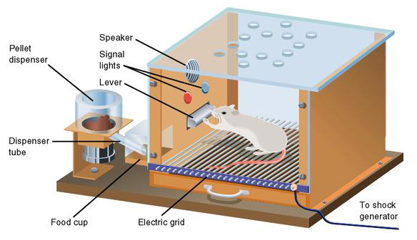
Learning
Classical conditioning
Intertrial interval (ITI)
CS
UCS
Notes:
In classical conditioning, the animal exerts little to no control over the CS (conditioned stimulus, e.g. a tone) and UCS (unconditioned stimulus, e.g. a shock or food).
In instrumental conditioning, the UCS is contingent on the behavior of the animal. In this case, the CS predicts the potential availability of the UCS.

Slide 3
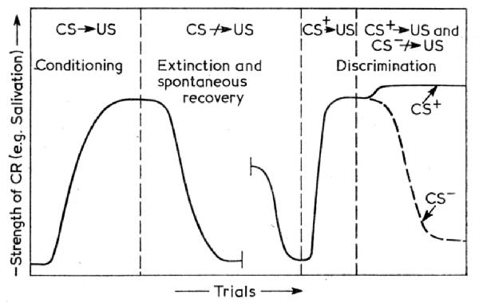
Learning
Classical conditioning
  Acquisition, extinction, re-acquisition.
Extinction and learning
  Given that reinforcement
  suddenly ceases, what
  inference should we make?
Notes:
The graph shows the strength of the conditioned response across learning trials. The CR can be anything from Salivation to Nosepokes (or other approach behaviors) for appetitive reinforcers and eyeblink, fear-potentiated startle, or simple avoidance for aversive reinforcers.
Image: http://s-f-walker.org.uk/pubs/lr/chapter3-lr.html

Slide 4
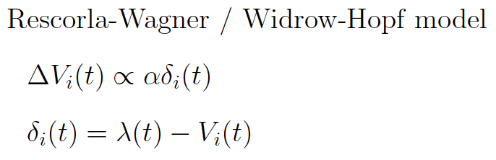
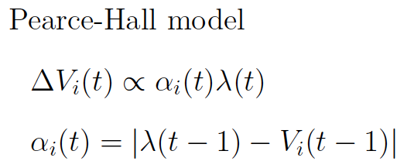
Learning
Option 1: Classical approaches to conditioning
  The associative approach (ala Rescorla-Wagner or Pearce-Hall)
    The associative strength for stimulus i at time t is V_{i}(t) predicts the likelihood of the USC give the particular CS; the magnitude of reinforcement at time t is λ(t).
    The notion of “associability” α_{i}(t) is used to describe how quickly a particular stimulus will be associated with a particular outcome.
    Example: A sudden bright flashing light is highly salient and unexpected. As a result it has a high associativity and will be quickly associated with a change in reward contingencies.
Notes:
A big change in the magnitude of reinforcement leads to a big change in associative strength. Each model of learning unpacks this a little differently – and allows them to explain slightly different behavioral observations.
The Rescorla-Wagner learning rule gives rise to temporal difference learning.

Slide 5
Learning
Several small problem with associative approaches
  Acquisition and re-acquisition do not occur at the same rate.
  Spontaneous recovery after extinction.
  Acquisition is general. Extinction is specific.
    Spontaneous recovery occurs in new contexts.
Notes:
Image: http://s-f-walker.org.uk/pubs/lr/chapter3-lr.html

Slide 6
Learning task structure
Problem statement
  Most of the observations we encounter are the product of unobservable or latent causes (e.g. the contingency CS ➔UCS). How can we efficiently learn about these latent causes and predict task observations?
An associative response
  We learn only to associate observations and only implicitly learn about latent causes via the associative structure of observations.
A Bayesian response
  We make probabilistic inferences about these underlying causes that structure our observations.

Slide 7
Learning task structure
Problem statement
  Most of the observations we encounter are the product of unobservable or latent causes (e.g. the contingency CS ➔UCS). How can we efficiently learn about these latent causes and predict task observations?
An associative response
  We learn only to associate observations and only implicitly learn about latent causes via the associative structure of observations.
A Bayesian response
  We make probabilistic inferences about these underlying causes that structure our observations.
Notes:
The central element of Bayes learning that makes it faster and more general than associative learning is that the hypothesis about the structure of the world can precede the data. This will often allow rather deep inferences about latent causes using relatively little data. In contrast, associative learning uses only the associations derived from the data. Gershman, Blei and Niv (2010) point out that connectionist approaches often build an associative (parameter) space that can capture the set of latent causes used in Bayesian learning. The associative response basically boils down to, “if we just take enough data and build a big enough hidden layer, we’ll work it out.” (This is giving short shrift to the associative folks.)

Slide 8
Learning task structure
A generative Bayesian approach:
  We assume learning is embedded within prediction. The goal of learning is to predict a future observation, o, from a set of previous observations, O.
  The term, M, refers to a world model that denote a set of relationships among different variables.
  Learning M from O is called model learning or structure learning.
  Each model provides the basis for predicting or generating future observations, o.
  These observations can be used for predicting reinforcers or any other part of a task.

Slide 9
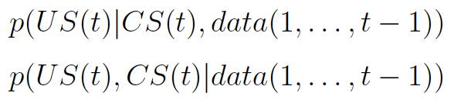
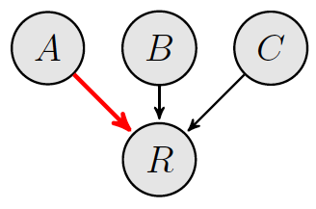
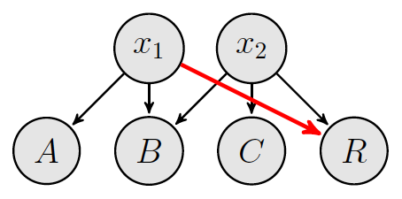
Learning task structure
What’s the purpose of the inference?
  The discriminative approach seeks only to predict reinforcers.
  The generative approach seeks to predict the full pattern of reinforcers and stimuli.
Courville, Daw and Touretsky (2006) Trends in Cog. Sci.
Notes:
The black lines indicate a higher probability of the reinforcer while the red lines indicate indicate lower probability of the reinforcer (e.g. inhibition). In the top discriminative model, the presence of stimulus A reduces the expectation of the reinforcer/US while the presence of B & C each increase the probability. In the bottom generative model, the first latent cause generates stimuli A and B but not the reinforcer R while the second latent cause generates B, C, and the reinforcer.
I’m going to focus on the generative approach for the remainder of the talk today.

Slide 10
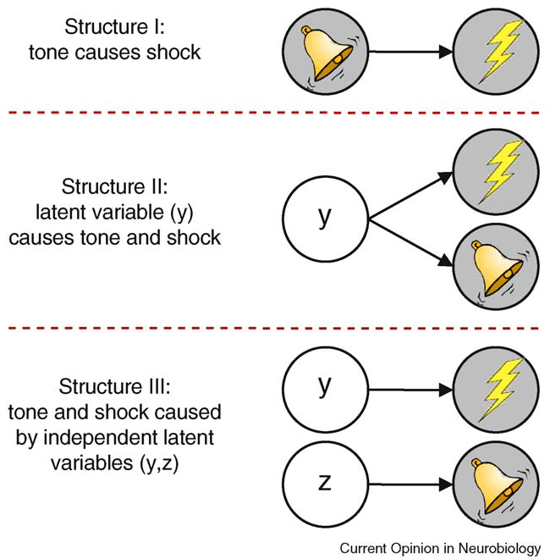

Learning task structure
Generative models for classical conditioning
  What’s the probability of the
  data given the proposed
  task structure.
Gershman and Niv (2010) Current Opinion in Neurobio.
Notes:
The tone could cause the shock. Structure 1.
The tone and the shock could be produced by some single latent cause. Structure 2.
The tone and the shock could be produced by two separate latent causes. Structure 3.

Slide 11
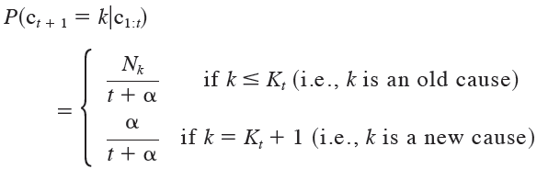
Learning task structure
Modeling extinction and spontaneous renewal
  Animals trained CS ➔UCS in context A.
  Conditioned responding is extinguished in context B.
  Animals are then tested in context C.
Predicting new latent causes
  A new latent cause is produced when a new context alters the reinforcement contingencies.
  The probability a new latent cause given K_{t} previously identified causes c given N_{k} observations generated by cause k is defined as
Gershman, Blei and Niv (2010) Psychological Review
Notes:
This is known as the Chinese restaurant process. Alpha is a prior parameter that varies how likely a new cause is. When alpha = 0, the model assumes that all observations

Slide 12
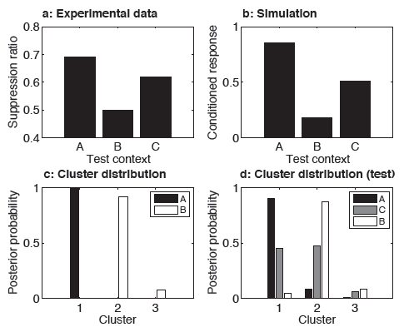
Learning task structure
Modeling extinction and spontaneous renewal
  Given a set of context and stimuli cues, we can predict the probability the UCS.
Gershman, Blei and Niv (2010) Psychological Review
Notes:
The model recapitulates the acquisition, extinction, and spontaneous renewal data from experiments. Moreover, the model (panel d) explains why low level renewal occurs in the novel context – it’s a mixture of the other two contexts and, consequently, a mixture of their predictions.

Slide 13
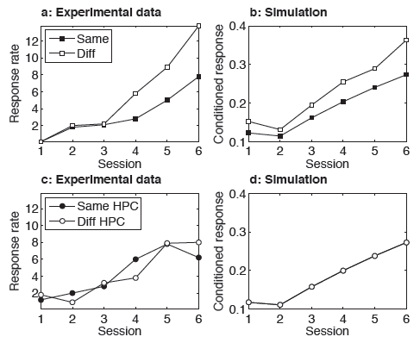
Learning task structure
Modeling latent inhibition
  In the Same condition, animals trained were on [CS ➔no UCS] followed by [CS ➔no UCS] in context A.
  In the Diff condition,
  each phase was
  train in different
  contexts.
  Hippocampal lesions
  were modeled as
  an inability to form
  new latent causes.
Gershman, Blei and Niv (2010) Psychological Review
Notes:
Notice that learning is slower in the Same condition – because all data is attributed to a single latent cause which decreases the response rate. The Diff condition produces several different latent causes.
This study suggests that the hippocampus may play a key role in the development of new latent causes. We will return to this point in our later discussions of hippocampal function.

Slide 14
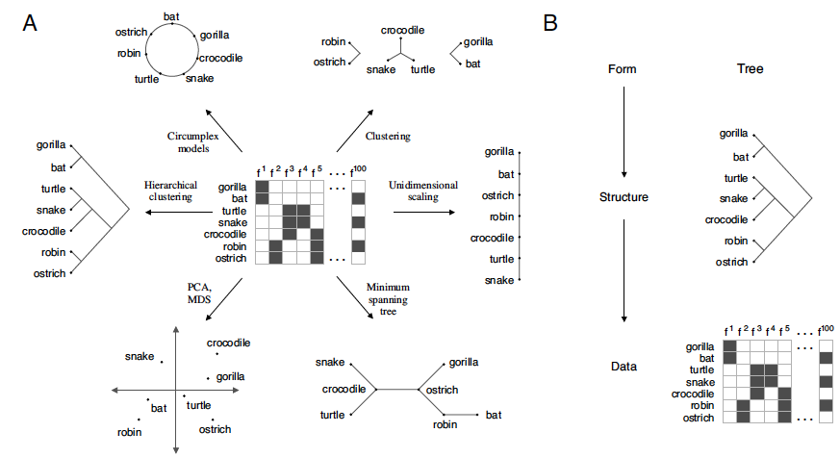
Structure learning
Organizing observations
  How should we organize a set of feature vectors?
  What makes one scheme (and instance) better than another?
Kemp and Tenenbaum (2008) PNAS
Notes:
We have many different possibilities. We could try to arrange our data as nodes on a circle or a linear spectrum. We could use clustering or tree structures.

Slide 15
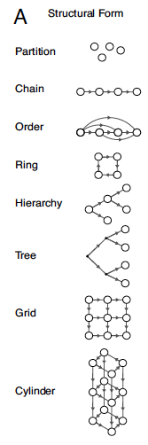

Structure learning
Building more complex models
  The form F and the particular structure S that best accounts for the data is the most probable.
  Most observations are organized according to one of a small number of forms.
Kemp and Tenenbaum (2008) PNAS
Notes:
A partition is what Gershman, Blei and Niv used. But there are a variety of other forms. Sequence information may be stored as a chain or order.

Slide 16
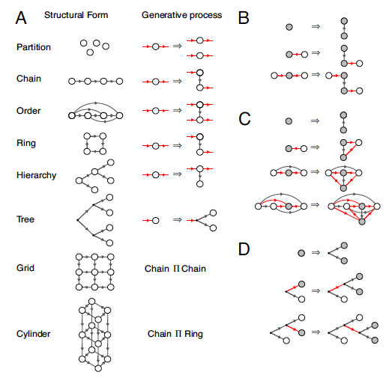
Structure learning
Building more complex models
  Generative grammar
  for model building
Kemp and Tenenbaum (2008) PNAS
Notes:
The grammar comes from node splitting within a graph. Each node inherits a set of connections expressing conditional dependence that follows it’s particular form. The development of these graphs allow the development of a particular structure for a given form.

Slide 17
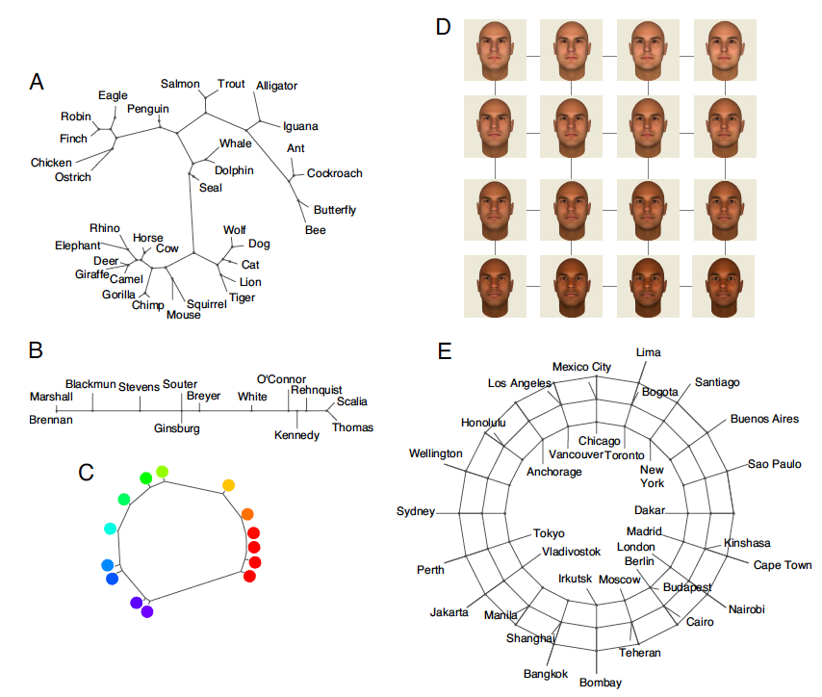
Structure learning
Kemp and Tenenbaum (2008) PNAS
Notes:
A – biological features; B – Supreme court justice decisions; C – similarity judgments between pure color wavelengths; D – faces as pixel vectors; E – distances between world cities.
The idea behind this analysis is that we would intuitively organize the data similarly.

Slide 18
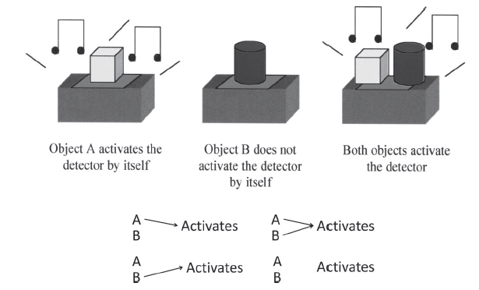
Structure learning
Language development in kids
  Given a “blicket” detector, what’s a “blicket”?
  Children as young as 2 years can quickly learn what a “blicket” is using what looks like Bayesian inference.
Gopnik and Wellman (2012) Psychological Bulletin
Notes:
The “blicket” detector makes a noise when an object called a “blicket” is placed on top of it. Can you find out what objects are “blickets”? More complex forms of inference (like backward blocking) develop later.

Slide 19
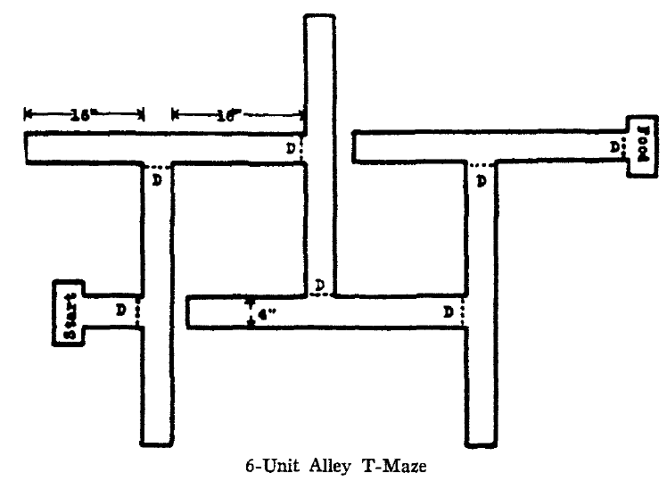
Learning structure
Can non-human animals learn task structure?
  Learning may not be expressed by an animal during task training.
  Expression of learning requires proper motivation.
  Latent learning learning occurs in the absence of a reinforcer/motivation.
Tolman (1948) Psychological Review
Notes:
Here’s a multiple T task used by Tolman and colleagues. The animals were trained to forage on this task for food. Since there are 5 T turns on the maze, chance performance is 2.5 errors.

Slide 20
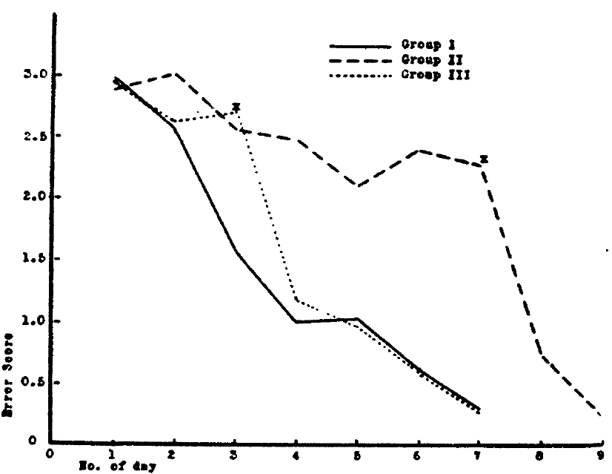
Learning task structure
Latent learning
  Rats learned the maze even in the absence of motivation.
Tolman (1948) Psychological Review
Notes:
Group I was trained on the task while food deprived. Group II was trained on free food for 3 days prior to food deprivation. Group III was trained on free food for a week prior to food deprivation.

Slide 21
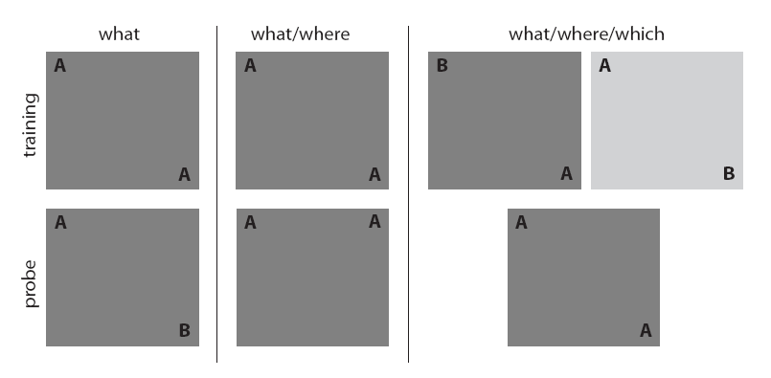

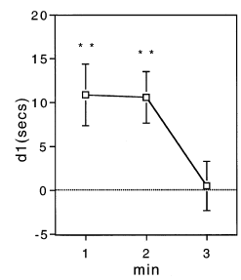

Simple exploration
Spontaneous object recognition/exploration
  Rodents will spontaneously attend to a novel or changed object in a known environment – in the total absence of reward.
Novel object
Dix and Aggleton (1999) Behavioral Brain Research
Notes:
The pattern of exploration suggests that rats remember “what” object was in the environment since they spend more exploring it over a familiar object. It is critical to remember that these are fully fed and watered animals.

Slide 22
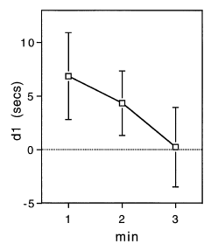
Simple exploration
Spontaneous object recognition/exploration
  Rodents will spontaneously attend to a familiar object in a new position.
Novel placement
Dix and Aggleton (1999) Behavioral Brain Research

Slide 23
Simple exploration
What/where/which and even when…
  Rats recognize out of place objects in relatively sophisticated contexts.

Slide 24
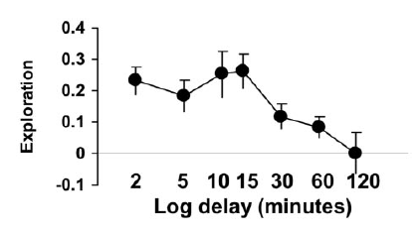
Simple exploration
What/where/which
  Rats spend more time exploring the object that is in the wrong location (given the context of the animal).
  But how do rats choose where to go?
Eacott and Norman (2004) Journal of Neuroscience
Notes:
But the key question is how do the animals assess the relative familiarity of these objects in places in contexts?

Slide 25
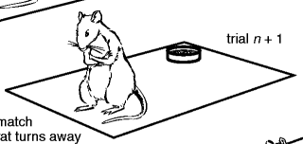
Types of exploration
Simple exploration
  Behavioral choice: go/no go for a semi-random walk
  Comparison: current O against expected O
  Behavioral measure: time at novel/control object
  Potentially inefficient
Should I stay (observing this empty corner) or should I go? The corner isn’t terribly surprising…

Slide 26
Types of exploration
Directed exploration
  Behavioral choice: where to go
  Comparison: all possible Os against expected Os for every sampling location
  Behavioral measure: sampling choice
  Potentially efficient
Would I find something unexpected if I went to the far corner? I might find a new odor. And I won’t find that at any
other position…

Slide 27
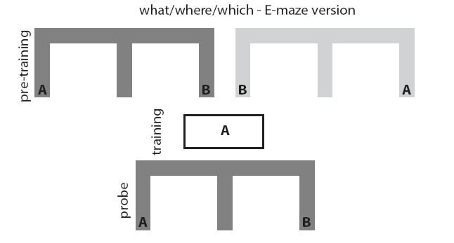
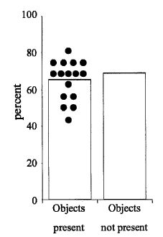
Directed exploration
What/where/which (but without cues)
  This version requires that the animal anticipates what observations it will be able to make at different locations.
  The task is hippocampal dependent when the objects aren’t visible from the choice point.
after Eacott et al. (2005) Learning and Memory

Slide 28
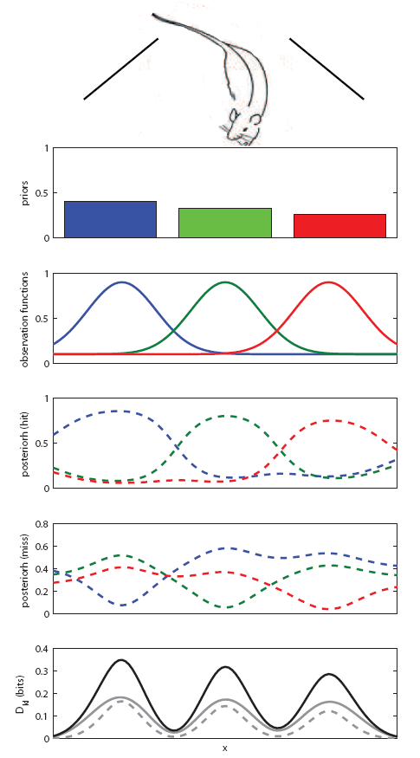
Modeling information foraging
A toy example
  Imagine a rat is attempting to determine which of three feeders is active. Each feeder dumps a pellet into a small one-dimensional tray (e.g. a gutter).
  Where should the animal sample in order to determine which feeder is active?
Notes:
Note that this is not a reward maximization problem!

Slide 29
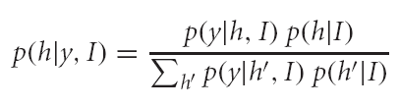
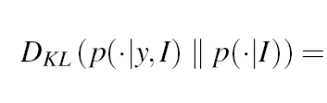
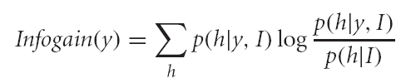
Information foraging
Efficient learning
  We can predict how a given observation y would change our probability of belief for different active feeder locations h using a Bayesian update.
  The difference between the prior (no observation) and posterior (with the observation) indicates how much information would be gained via the observation. The information gain can be computed by the KL divergence.

Slide 30
Information foraging
KL divergence
  D_{KL} quantifies the information gained from a given observation and can be used to identify the most informative sampling regions.
Johnson et al. (2012) Frontiers in Human Neuroscience

Slide 31
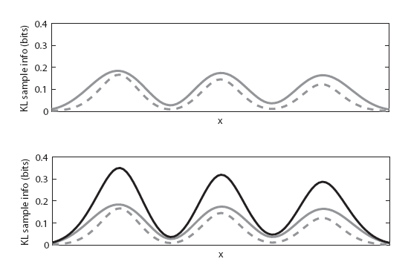
Information foraging
Simple exploration
  D_{KL} can be computed for any given observation and used as a measure of familiarity and as a learning signal.
    A high D_{KL} for a given observation suggests that the observation is novel/unexpected and learning is needed.
    A low D_{KL} for a given observation suggests that the observation is familiar/expected and learning is unnecessary.
    solid gray line – information gain for a pellet observation
    dashed gray line – information for no pellet observation
Notes:
Question: What’s the intuition behind these information gain curves? Why are the extrema located as they are?

Slide 32

Information foraging
Directed exploration
  The expected D_{KL} (information gain) can be used to identify the most informative sampling regions.
  solid gray line – information gain for a pellet observation
  dashed gray line – information for no pellet observation
Notes:
Note that in order to take this expectation across the observations (y)

Slide 33
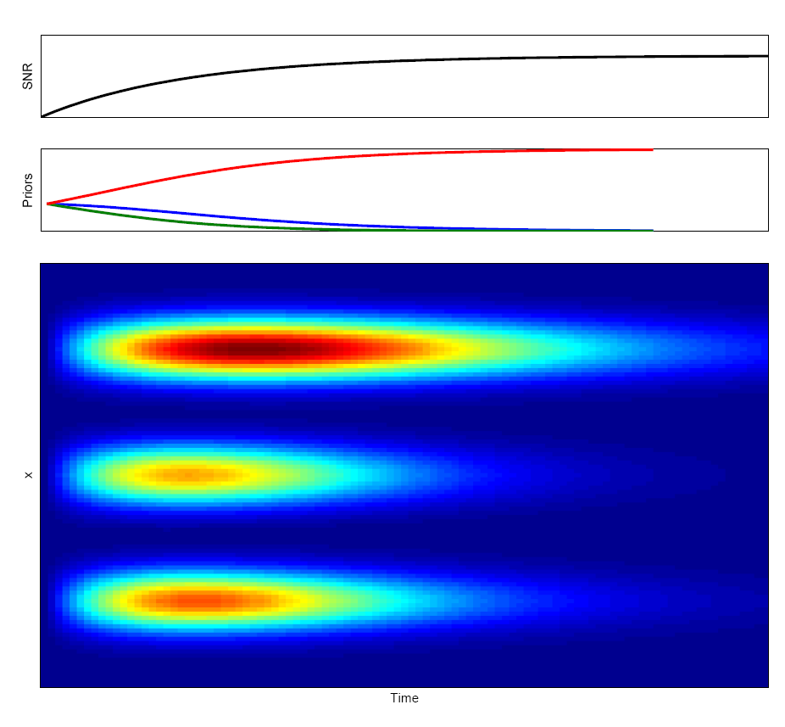
Information foraging across time
Observation functions
Color indicates expected D_{KL} information gain at a given position
Johnson et al. (2012) Frontiers in Human Neuroscience
Notes:
Let’s imagine that we know that there are three potentially active feeders. We know where their centers are, but we don’t know their specificity (e.g. how wide the Gaussian distribution for the pellet bounces is). This precision develops with learning. As the precision develops, so does difference in the amount of information gained from sampling different locations.
Later as one of the feeder locations becomes increasingly probably, the expected information gain decreases since there are likely no unexpected observations that will be produced.
As a result, this suggests a particular pattern of exploration to exploitation.

Slide 34
Information foraging across time
Efficient sampling behavior during learning
  Initial random foraging
    Unknown observation functions / Multiple competing hypotheses
    Chance memory performance / Longer sampling after novel observations
  Directed information foraging
    Known observation functions / Multiple competing hypotheses
    Above chance memory performance / Exploration directed toward highly informative regions.
  Directed reward foraging
    Known observation functions / Single winning hypothesis
    Memory performance at ceiling / Cessation of exploration.

Slide 35
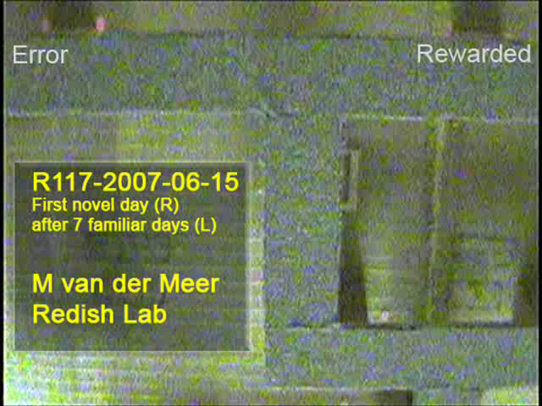
Information foraging from memory
Vicarious train and error (VTE)
  This idiosyncratic behavior suggests that the animal is vicariously testing its options by sampling from memory.
Notes:
VTE behaviors suggest that animals may sample from a memory space rather than explicitly sampling from a behavioral space.

Slide 36
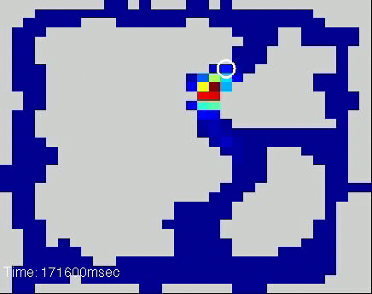
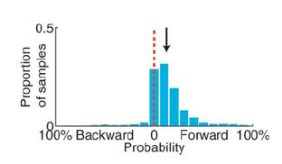
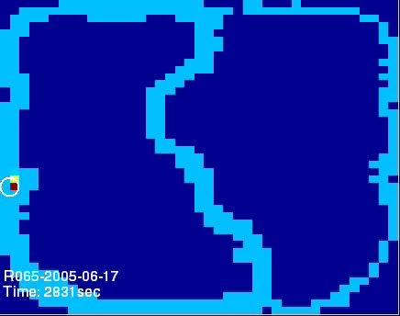
Information foraging from memory
VTE-like spatial dynamics
  Reconstruction (neural decoding) of the rat’s position moves ahead of the animal at choice points.
  This appears as noise.
  Spatial representations
  appear to sample the
  most informative parts of
  the memory space.
HC
Johnson and Redish (2007) Journal of Neuroscience

Slide 37
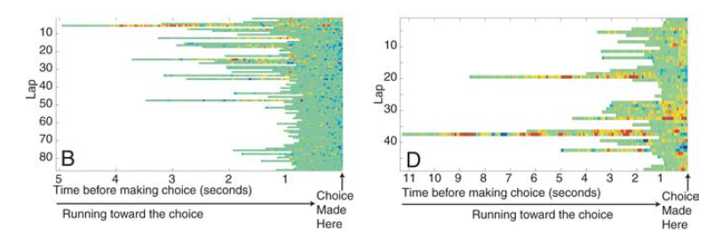
Information foraging from memory
Efficient memory sampling should reflect learning
  Non-local sampling should reflect behaviorally observable sampling behavior such as VTE.
  It does.
Johnson and Redish (2007) Journal of Neuroscience

Slide 38
Structure learning summary
Generative Bayesian learning
  Generative Bayesian learning suggests that a set of latent causes lead to task observations (stimuli and reinforcers).
  These models capture learning dynamics on many tasks ranging from classical conditioning in rodents to high-level language information organization in children.
Information foraging
  Simple exploration is guided by the KL divergence (or similar metric) for the Bayesian update. This is the information gain by the observation.
  Directed exploration is guided by an expected KL divergence. This is the information expected to be gained at any location. It can be used in place of a value function to guide sampling.

Slide 39
Structure learning summary
The Bayesian brain
  The hippocampus (along with frontal cortices) appears to play a central role in generative Bayesian learning.
  Gershman, Blei, and Niv’s (2010) model suggests that the hippocampus is critical for positing new latent causes.
  Findings by Eacott et al. (2005) and Johnson and Schrater (2012) suggest that the hippocampus underlies directed exploration.
  Findings by Tolman (1948, behavior) and Johnson and Redish (2007, neurophysiology) suggest that hippocampal place cell dynamics potentially allow animals to vicariously sample from different latent causes.

Slide 40
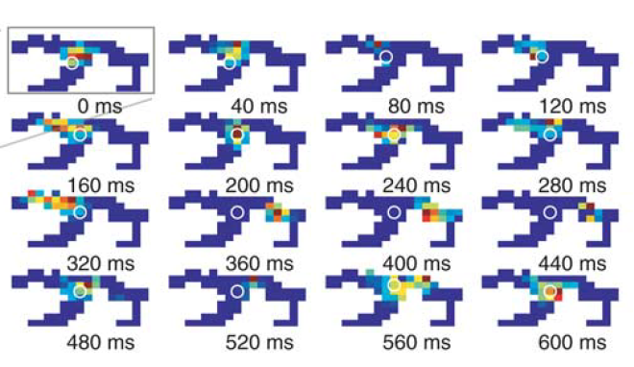
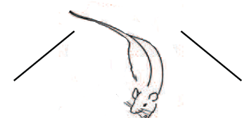
Schemas in the hippocampus
Motivation
Question:
  Why did the position reconstructed from hippocampal place cell activity move to the particular locations it did?
Answer:
  The animal uses schemas to navigate through a memory space.
Johnson and Redish (2007) J Neurosci.

Slide 41
Schemas as structure learning
Behavioral evidence for schemas
  Schemas facilitate learning and consolidation
    One-trial learning and speeded consolidation occur after development of schemas (Tse et al., 2007)
  Schemas structure imagination and exploration
    Hippocampal lesions compromise spontaneous generation of coherent imaginative episodes (Hassabis and Maguire, 2007)
  Schemas capture statistical structure
    Schemas and scripts organize information (Schank and Abelson, 1977; Bower, Bloack, Turner, 1979)
  Schemas cause interference on memory tasks
    Activation of an inappropriate schema reduces memory performance
    (Bartlett, 1933)

Slide 42
Schemas contribute to single trial learning and fast memory consolidation

Slide 43
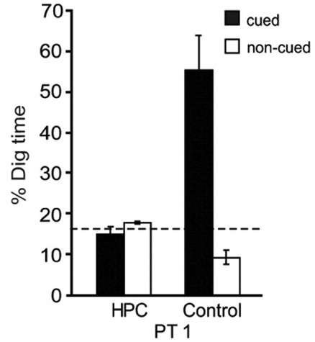
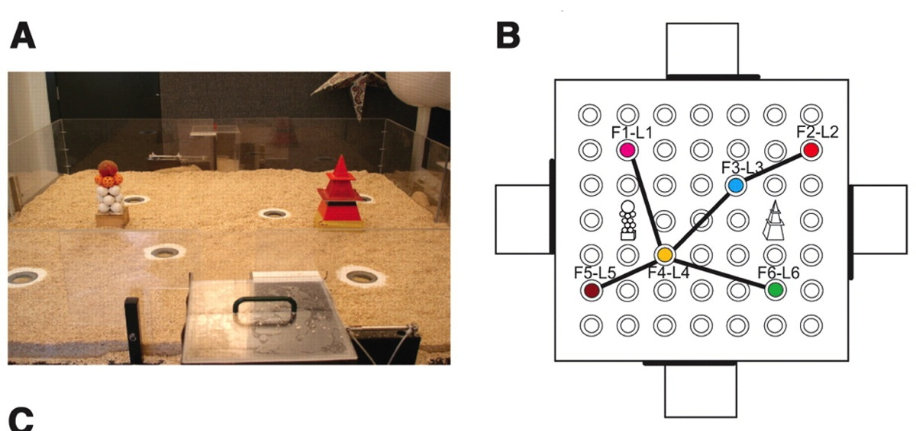
Schema learning
The paired associate task
  Animals learn to associate a flavor cue
  with a reward location
  A hippocampus dependent learning task
Tse et al. (2007) Science

Slide 44
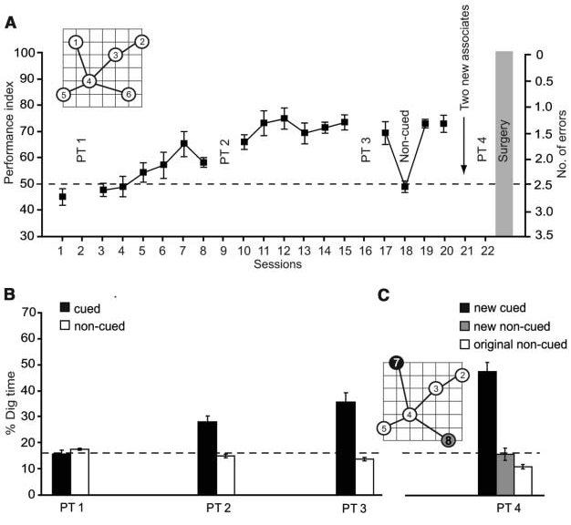
The paired associate task
New PAs can be
learned on a
single trial
But only after an
initial training
period.
Tse et al. (2007) Science

Slide 45
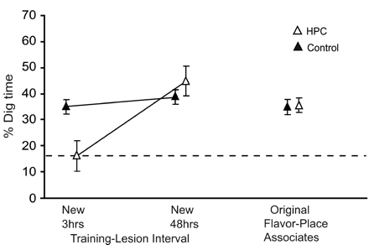
The paired associate task
Fast consolidation
  Hippocampal lesions 48 hours after a single learning trial did not affect new PAs.
  Hippocampal lesions 3 hours after a single learning trial did affect learning.
Tse et al. (2007) Science

Slide 46
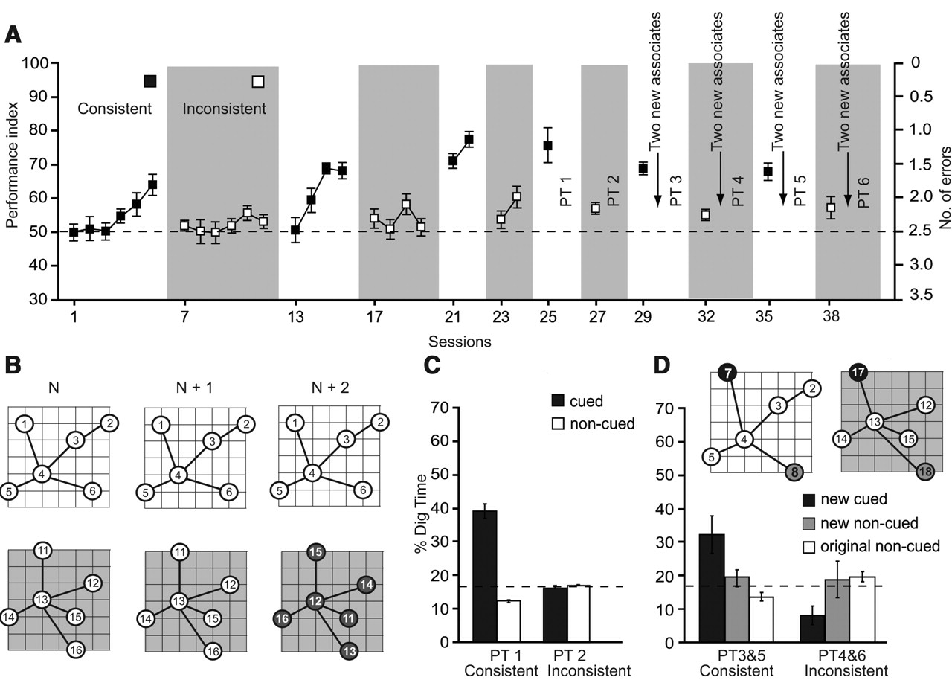
The paired associate task
Task statistics matter

Slide 47
Bayesian learning
Foundations:
  We assume schema learning is embedded within prediction. The goal of learning is to predict a future observation, o, from a set of previous observations, O.
  We define a memory schema or model, M, as set of relationships that can be used for:
  Storage and learning: Schemas act as a surrogate for the set of all previous observations, O. This is model learning.
  Prediction: Predictions are conditioned on schemas.

Slide 48
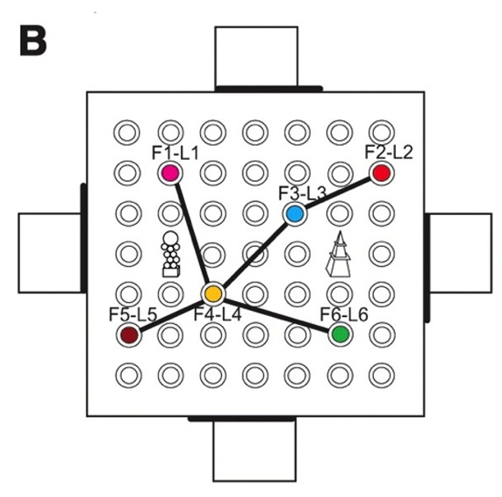
Schemas on the paired associate task
The function of schemas:
  Identify which variables are important
  Identify the general relationships among these variables
  Make specific predictions as little data as possible
Paired associate task
Predictive variables
Observation
Start Box Flavor
Reward outcome
Start Box Location
Sample location

Slide 49

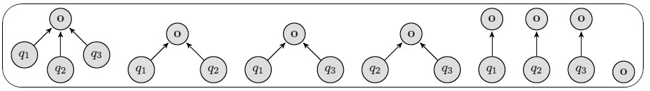
Model learning
Learning which variables are important
  We use Bayes’ rule to determine which which model, M, best accounts for the set of past observations, O. The data are the the combination of state and observation information for every trial.
  Models available for 1, 2, and 3 predictor variables (cues)
    The models are proxies for schemas.
    Each model provides a different conjunctive code.
    The conjunction of variables used in the model define a state.

Slide 50


Parameter learning
Learning the relationships among variables
  The end goal of the project is to predict what observations will arise from a given state.
  We can predict the observations using
  a categorical distribution:
  where K is the number of possible observations and is the probability of a particular observation.
  For example, we might want to predict whether a particular state will yield:
  (o₁ = no reward), (o₂ = 1 pellet), (o₃ = 3 pellets)
  In order to predict an observation, we must learn the parameters for the categorical distribution:

Slide 51


Parameter learning
Learning the relationships among variables
  We use hierarchical Bayesian inference in order to determine
  from an observation o:
  The hierarchy embedded within Bayes’ rule allows us to learn the parameterization by sequentially updating a set of hyperparameters :
  where c_{s} is a count of each type of observation and Dir( ) is the Dirichlet distribution.

Slide 52
Parameter learning
A visual tutorial of Dirichlet distributions
  Assume that we have three possible observations (K = 3).
  Before we collect any data the distribution is uniform.
o₁
o₂
o₃
Notes:
Show c = [0 0 0], c = [10 0 0], c = [0 10 0]
Show c = [10 10 0], c = [0 10 10], c = [10 10 10]

Slide 53
Parameter learning
A visual tutorial of Dirichlet distributions
  Assume that we have three possible observations (K = 3).
  If we only observe o₁.
o₁
o₂
o₃
Notes:
Show c = [0 0 0], c = [10 0 0], c = [0 10 0]
Show c = [10 10 0], c = [0 10 10], c = [10 10 10]

Slide 54
Parameter learning
A visual tutorial of Dirichlet distributions
  Assume that we have three possible observations (K = 3).
  If we only observe o₂.
o₂
o₁
o₃
Notes:
Show c = [0 0 0], c = [10 0 0], c = [0 10 0]
Show c = [10 10 0], c = [0 10 10], c = [10 10 10]

Slide 55
Parameter learning
A visual tutorial of Dirichlet distributions
  Assume that we have three possible observations (K = 3).
  If we only observe o₁ and o₂ with similar frequency but not o₃.
o₁
o₂
o₃
Notes:
Show c = [0 0 0], c = [10 0 0], c = [0 10 0]
Show c = [10 10 0], c = [0 10 10], c = [10 10 10]

Slide 56
Parameter learning
A visual tutorial of Dirichlet distributions
  Assume that we have three possible observations (K = 3).
  If we only observe o₁ most frequently, o₂ sometimes, but not o₃.
o₁
o₂
o₃
Notes:
Show c = [0 0 0], c = [10 0 0], c = [0 10 0]
Show c = [10 10 0], c = [0 10 10], c = [10 10 10]

Slide 57
Parameter learning
A visual tutorial of Dirichlet distributions
  Assume that we have three possible observations (K = 3).
  If we only observe o_{1,} o₂ , and o₃ with similar frequencies.
o₁
o₂
o₃
Notes:
Show c = [0 0 0], c = [10 0 0], c = [0 10 0]
Show c = [10 10 0], c = [0 10 10], c = [10 10 10]

Slide 58
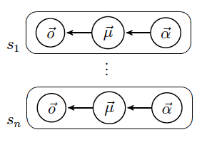
Parameter learning
Learning the relationships among variables
  Schematic relationships among variables develop when hyperparameters are shared across states as a mixture of α’s.
Specific expectations
in the parameters
General expectations
for the parameter
distributions
Observations
Notes:
The fundamental problem with the hippocampus providing the basis for conjunctive learning is that learning across all conjunctions is an incredibly slow process since it dilutes sampling. We address this problem by sharing hyperparameters as a mixture.

Slide 59
Prediction
One trial learning – without schemas
  Without schema learning, a single trial produces a slight change in the parameterization.
  An isolated observation without a schema produces very little change in the expected observation.
o₁
o₂
o₃

Slide 60
Prediction
One trial learning
  Schematic relationships are
  contained in the mixture of
  parameter distributions across
  all states.
  The top mixture shows that every
  state consistently produces either
  o₁ or o₂, but not both observations.
  The task representation has a
  good predictive structure.
  The bottom mixture shows that
  every state consistently produces
  both o₁ and o₂ with similar
  frequencies.
  The task representation has a
  poor predictive structure.
Notes:
For a deterministic task

Slide 61
Prediction
One trial learning – with schemas
Good predictive structure
o₁
o₂
o₃
Poor predictive structure
o₁
o₂
o₃

Slide 62
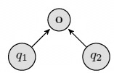
Paired associate learning
Model learning: what variables are important?
  Three potential predictive variables:
  q₁ = sample location, q₂ = flavor cue, q₃ = start box location

Slide 63
Paired associate learning
Parameter learning: how are the variables related?
  The correct model learns that most states are always unrewarded while a smaller subset are always rewarded.
  Alternative models suggest that all states are partially rewarded.

Slide 64
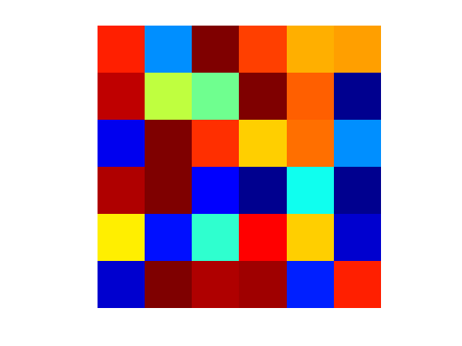
Paired associate learning
Specific state-based predictions
  Good task representations
State representation
Flavor
Location
Notes:
If we use the right task representation

Slide 65
Paired associate learning
Specific state-based predictions
  A poor task representation
State representation
Start box
Location
Notes:
If we use the wrong task representation

Slide 66
Paired associate learning
Specific state-based predictions
  The task representation will work but develops very slowly
State representation
Location
Flavor
Start box
Notes:
If we use too complex of a task representation

Slide 67
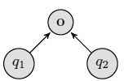
Paired associate learning
The schema for the PA task
  The model identifies the two predictive variables:
    q₁ = sample location, q₂ = flavor cue
  The conjunction of the predictive variables
  form the state-space and proper representation
  for the task.
    The state-space supports prediction.
  The generalized prior captures task structure.
    Learning task structure
    supports single trial
    learning.
State representation
Flavor
Location

Slide 68

Paired associate learning
Schemas and consolidation
  Novel paired associate
  memory becomes
  independent of the
  hippocampus in 3-48 hours.
  If consolidation is related to the
  stability of a task-based inference
  then schemas can speed consolidation
  processes by increasing stability.
Tse et al. (2007) Science
Notes:
Notably, the distributions on the bottom-right are not yet stable. New observations can produce a considerable change.

Slide 69
Paired associate learning
Schemas and consolidation
  A single training trial leaves the new PA prediction quite malleable and unstable.
  We hypothesize that reactivation-based learning is contingent on the coherence of the prediction p(o|M). Reactivation only occurs if the entropy of the prediction is sufficiently small.
  We computed the expected KL divergence for the Bayesian update as a measure of stability for a given PA.
Notes:
The expected KL divergence is simply the KL divergence for each observation (at each state) weighted by the probability of making each observation.

Slide 70
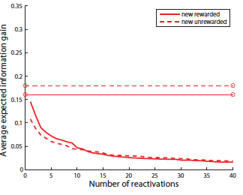
Paired associate learning
Schemas and consolidation
  We propose that reactivation is contingent on the entropy of a PA.
    High entropy PA states are replayed (sampled from memory) less frequently than low entropy states.
  The stability of the schema is found by measuring the extent to which a new sample will alter the schema.
    We compute stability using
    the expected information
    gain.
    For consistent training,
    stable Pas can be achieved
    in approximately 20-30
    reactivations.

Slide 71
Paired associate learning
Schemas in the inconsistent training condition
  The no potential predictive variables model generally wins out.
  Each of the models reflects the lack of consistent task contingencies.

Slide 72
Paired associate learning
Simultaneously learning consistent and inconsistent tasks
  The model that best accounts for learning on this task includes: spatial position, the flavor cue, and the context.
  The mixture required to produce an appropriate prior for one trial learning must now be hierarchical conditioned on the context.

Slide 73


Paired associate learning
Dimensionality reduction
  The start box dimension
  doesn’t provide useful
  information for
  prediction.

Slide 74
Paired associate learning
Dimensionality reduction
  No dimension provides
  any information useful
  for prediction.

Slide 75
Paired associate task
Summary of modeling results
  The modeling approach successfully captures single trial learning on the paired associate task using individual task data.
  Single trial learning is dependent on development a schematic representation of the task. The task schema includes:
    A state-space formed by the conjunction of predictive variables.
    The outcome predictions given by the state-space.
    A prior that is the mixture of the hyperparameters across states.
  Stability of novel paired associates in the consistent learning condition is not immediate but occurs after 20-30 reactivations.
    Without well-formed task schemas, many more training trials are required to form stable paired associate predictions and induce reactivation.
Notes:
Furthermore, we assume that reactivation does not contribute to learning when predictions are incoherent.

Slide 76
Schemas shape hippocampal place cell activity

Slide 77



Schemas in the hippocampus
Place cells and overdispersion
  Place cell discharge is far more variable – overdispersed – than simple noise is expected to be.
  Overdispersion is task
  dependent
    Jackson and Redish (2007)
    Kelemen and Fenton (2010, 2013)
Fenton and Muller (1998) PNAS
Notes:
Overdispersion is generally explained as the use of multiple hippocampal maps or reference frames.

Slide 78


Schemas in place cell activity
Overdispersion in directional place cell activity
  Place cells fire directionally
  on the linear track.
  Splitting activity into
  direction- and place-
  based tuning curves
  reduces overdispersion.
Jackson and Redish (2007) Hippocampus

Slide 79

Schemas in place cell activity
Splitting place cells
  Place fields split, particularly on simple alternation tasks, to reflect the animal’s trajectory.
  Place field activity reflects past or future trajectories.
Wood and Eichenbaum (2000) Neuron

Slide 80
Schemas in place cell activity
Overdispersion in directional place cell activity
  Observations: Reward / No reward
  Potential predictive variables:
    q₁ = location, q₂ = last reward location, q₃ = last direction of movement
  Proper state representation
    q₁ = location, q₂ = last reward location
    State should be a
    combination of
    place and reward
    location.

Slide 81

Schemas in place cell activity
Overdispersion in a general memory task
  Context guided object discrimination
    Animals are rewarded for
    a particular odor in one
    context and the opposite
    odor in the other context.
Komorowski et al. (2009) J Neurosci

Slide 82
Schemas in place cell activity
Overdispersion in place cell activity
  Observations: Reward / No reward
  Potential predictive variables:
    q₁ = context, q₂ = item, q₃ = location within box, q₄ = random distractor
  Proper state representation
    q₁ = context, q₂ = item, q₃ = location within box
    State should be a
    combination of
    the box, the odor cue,
    and location within
    box.

Slide 83

Schemas in place cell activity
Place cell activity in the context guided discrimination task
  Place cell activity is cue and context sensitive
  Inactivating mPFC reduces the cue specificity of place coding
Navawongse and Eichenbaum (2013) J Neurosci

Slide 84

Schemas in place cell activity
Finding simpler representations than place
  A rat can solve this task using two different types of representation
    For random foraging, it must use spatial position.
    But if the animal uses a stereotyped path, it can also use trajectory position.
Singer et al. (2010) J Neurosci.

Slide 85
Schemas in place cell activity
Finding simpler representations than place
  We modeled learning on the W-maze using simple TD learning and altered exploration/exploitation by varying the softmax β.
  We used the sample observations from the exploratory and exploitation phases.
Exploration
Exploitation

Slide 86
Schemas in place cell activity
Optimal representations – random foraging
  Observations: Reward / No reward
  Potential predictive variables:
    q₁ = spatial location, q₂ = last movement direction, q₃ = 2nd to last movement direction, q₄ = 3rd to last movement direction
Last movement direction: q₂
Spatial location and last movement direction: q₁, q₂
Notes:
There are 16 possible models and 704 states in the full model (fewer in each of the conjunctive models).

Slide 87
Schemas in place cell activity
Optimal representations – stereotyped behavior
  Observations: Reward / No reward
  Potential predictive variables:
    q₁ = spatial location, q₂ = last movement direction, q₃ = 2nd to last movement direction, q₄ = 3rd to last movement direction
Trajectory direction and location
Spatial location only: q₁
Last three actions: q₂, q₃, q₄
Notes:
There are 16 possible models and 704 states in the full model (fewer in each of the conjunctive models).

Slide 88

Schemas in place cell activity
Learning how to efficiently represent position
  Sometimes more compact representations than place are possible.
Singer et al. (2010) J Neurosci.

Slide 89
Schemas in place cell activity
Schemas in place cell activity
  Place cell activity generally reflects the best predictive representations. Overdispersion can be understood as a sifting through potential representations.
  Spatial location is almost always one of the best predictors of task-related observations.
  But in some cases, spatial location should be “split” in order to more form a richer state-space that allows better prediction of task-related observations.
    Refining place cell activity is likely driven by mPFC.
  And in other cases of stereotyped behavior, place information can be discarded for position in trajectory information.

Slide 90
Schemas form the basis of exploration

Slide 91

Spontaneous exploration
Novelty induced exploration.
  Spontaneous exploratory behavior occurs in a variety of tasks.
  Exploration is driven by the representation used by the animal.
Johnson et al. (2012) Frontiers in Human Neuro.

Slide 92
Spontaneous exploration
Model learning for the “what” task
  Observations: Reward / No reward
  Potential predictive variables:
    q₁ = location, q₂ = random, q₃ = session (train/test)
Location only
Location and session

Slide 93


Spontaneous exploration
How much information does an observation provide?
  We compute the KL divergence for the Bayesian update
  (using the prior and posterior of the model probability).
  We can also compute the KL divergence for the parameterization of each model.
  This leads to a family of curves that indicate how much a single observation changes each model.
  The curve associated with the task schema used by the animal should predict the individual’s spontaneous exploration behavior.
Johnson et al. (2012) Frontiers in Human Neuro.

Slide 94
Spontaneous exploration
Model learning for the what task
  Observations: Object 1, Object 2, Empty
  Potential predictive variables:
    q₁ = location, q₂ = random, q₃ = session (train/test)
  Novelty signals can be found by determining how the observation changes predictions.

Slide 95
Spontaneous exploration
Model learning for the what task
  The appropriate representation yields the highest information per sample at the novel object location.
B
A

Slide 96


Spontaneous exploration
Higher order exploration
  We trained animals on a standard exploration task with two set of objects during the training session.
  One set (the trains) were replaced as in the standard what task.
  The other set (the owls) were held constant as a control.
  For animals were trained daily for two weeks with each set varied across positions.
Training
Test

Slide 97

Spontaneous exploration
Exploration behavior during the test phase
  Novel object, control object, unchanged pair.
  Rats explore the novel object in a characteristic sequence.
Exploration time (s)
Session time (s)
Notes:
All four animals displayed a characteristic pattern of exploration. The animals first explored the novel object, then the control object (that did not change), then the novel object. Animals varied in how fast they ran through this sequence but not the overall pattern.

Slide 98
Spontaneous exploration
Exploration behavior during the training phase
  Novel object, unchanged pair.
  Animals explore objects that will potentially switch.
Exploration time (s)
Session time (s)

Slide 99
Spontaneous exploration
Summary
  We can model schema learning on spontaneous recognition tasks.
  Schema learning can be used to predict a novelty or mismatch signal that is associated with updating a representation during learning.
  These novelty signals can be used to predict behavior on spontaneous object exploration tasks.
Applications:
  Novelty signals can be used to determine the specific representation an individual uses to solve a task. These might also be used as regressors in neuroimaging tasks.
  We can use the model to build training sequences that either lead toward or away from appropriate task representations.

Slide 100
Full summary
Schemas and single trial learning
  Hierarchical predictive modeling predicts the representation used by an individual on a particular task and captures single trial learning and time variable consolidation.
Schemas at place cell activity
  Hierarchical predictive modeling accounts for place cell dynamics including overdispersion, development of multiple place fields, and potentially, top-down remapping.
Schemas and spontaneous exploration
  Hierarchical predictive modeling accounts for observational surprises and spontaneous exploration times.
  It also provides a representational prediction error similar to, but more general than the dopamine prediction error in RL.
Notes:
(1) This provides a more natural account than the neural networks approach in which each trial is viewed as a training epoch. Additionally, this approach makes explicit the latent structure of the task while the neural networks approach leaves this structure hidden within the connections.

Slide 101
Acknowledgements and thanks
  Collaborators
    Paul Schrater – University of Minnesota
    Mike Hasselmo, Howard Eichenbaum, Sam McKenzie – Boston University
  Students
    Sarah Venditto – Bethel University
    Luke Horstman – Bethel University
  Good conversations
    David Redish – University of Minnesota
    Matt van der Meer – University of Waterloo
    Bruce Overmier – University of Minnesota
  Support:
    Office of Naval Research/Conte Center (Hasselmo/Eichenbaum)

Slide 102

Model learning
Learning which variables are important
  A model is a hypothesis about the relationship between potential predictive variables, q_{i}’s, and an observable outcome, o.
  Imagine that we have two potential predictive variables, q₁ (tone on/off) and q₂ (home cage, testing arena). We then have four different potential models.

Slide 103
Model learning
Learning which variables are important
  A state is a combination of potential predictive variables for a given model.
  Let’s assume that we are learning in a cued fear conditioning task where: q₁ (tone on/off) and q₂ (home cage, test arena).
  The model that includes q₁ and q₂ has four states:
  s₁ = (q₁ = tone on, q₂ = home cage); s₂ = (q₁ = tone off, q₂ = home cage);
  s₃ = (q₁ = tone on, q₂ = test arena); s₄ = (q₁ = tone off, q₂ = test arena);
  The model that includes only q₂ has two states:
  s₁ = (q₂ = home cage); s₂ = (q₂ = test arena);

