Slide 1
Gaurav Aggarwal, Mark Shaw, Christian Wolf
Image Reconstruction from Human Brain Activity

Slide 2
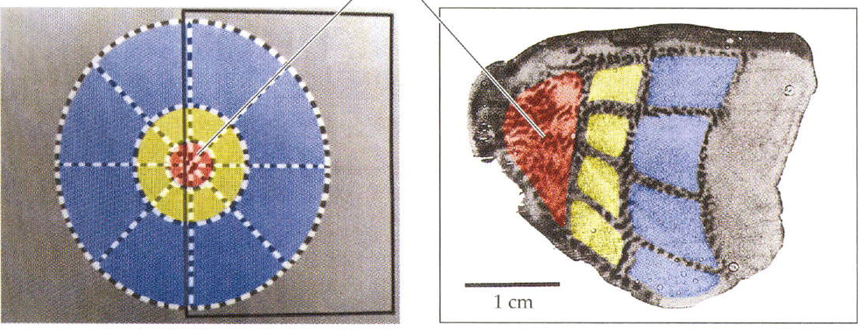
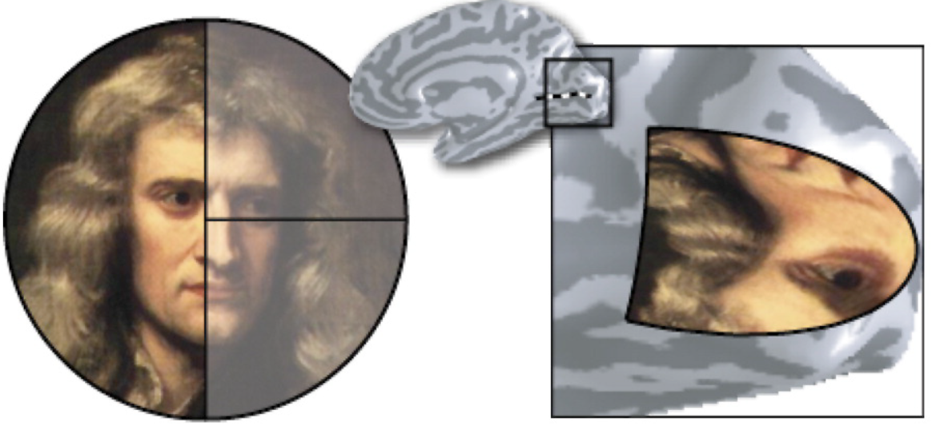
Retinotopy
Fovea
Visual Field
Visual Cortex
Notes:
Neurons which are close together in visual cortex respond to the same location in the visual field. This creates a retinotopic map on the cortex, with locations in the center of the visual field have an inflated representation on the brain like a blown up balloon.

Slide 3
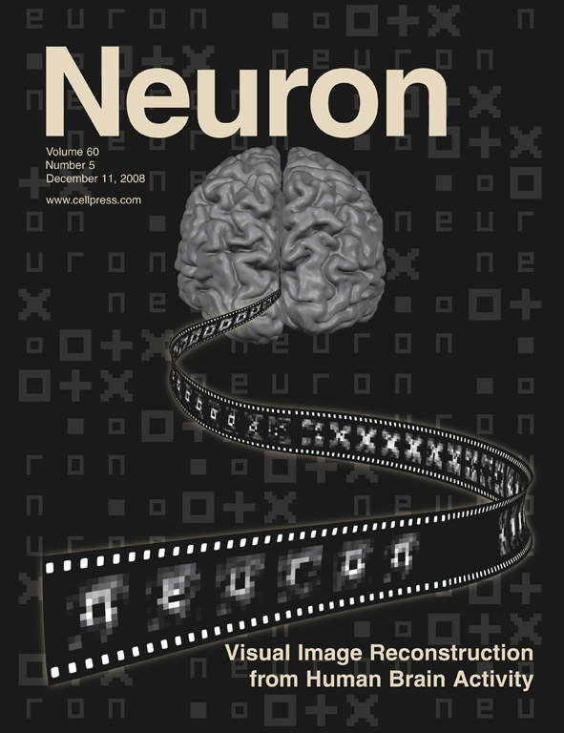
Classification
Yoichi Miyawaki (2008)
Notes:
In 2008 Miyawaki and colleagues made headlines and the front page of Neuron when they used the retinotopy of the visual cortex and activity in an fMRI scanner to reconstruct the images that people saw from their brain activity.

Slide 4
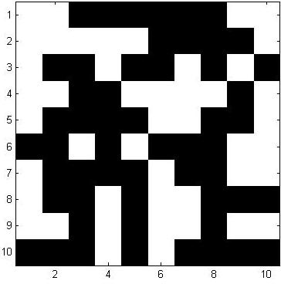
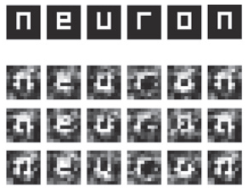
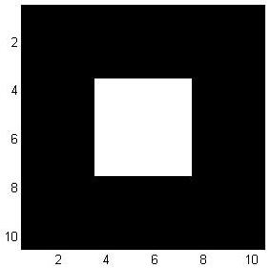
Procedure Miyawaki et al. (2008)
Train on Random Images (fMRI) 10 x 10 black-white Pixels
Reconstruct Target Images from V1,V2,V3 activity
Notes:
Their experiment consisted of two phases, in the first a random array of pixels which were white and black on a 10 by 10 grid were shown. Afterwards brain activity here is used to train classifiers.
Then actual objects are shown on the same grid, and brain activity here is used only to test the classifier’s accuracy.
Here you can see the reconstruction letter by letter of the word neuron.

Slide 5
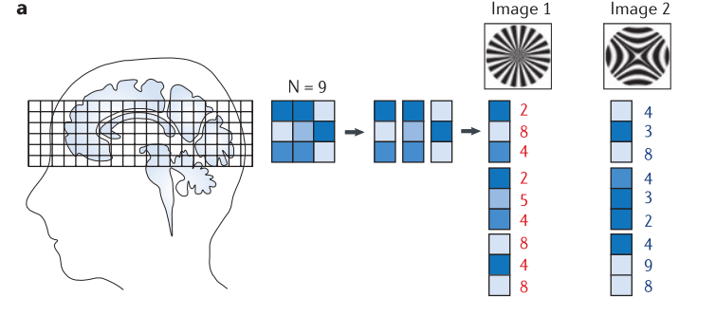
How?

Slide 6
How?

Slide 7
1*1 Decoder
Basis
1
1
1
1
1 1
1*2
Decoder
Basis
1 1
1
1
1
1
2*1 Decoder
Basis
2*2 Decoder
Basis
1 1
1 1
Notes:
Most Trivial way to classify is to consider each brain voxel individually
Can a certain pattern of brain activity be indicitive of whether a pixel was black or white?

Slide 8
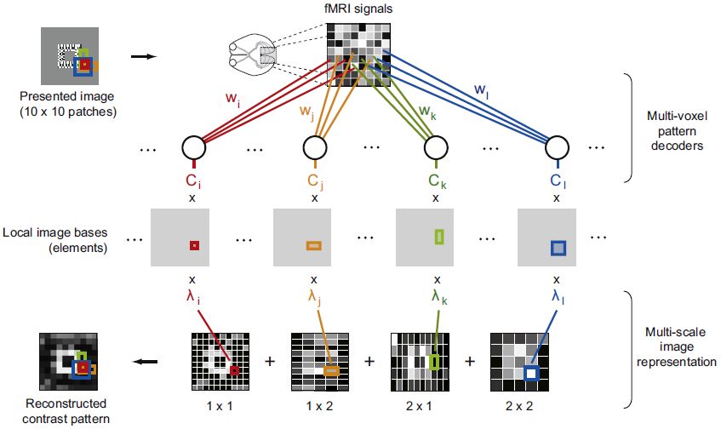
Notes:
Participants shown 10*10 grid of pixels, obtain an fMRI signal
Can a certain pattern of brain activity be indicitive of whether a pixel was black or white?
Decoder tries to see how certain groups of voxels correlate with pixel
1*1:
1*2: picks up vertical contrast
2*1: picks up horizontal contrast
2*2: corners/edges

Slide 9
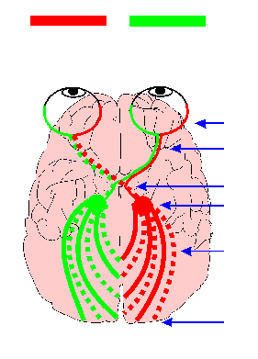
Goals of the 2 week project
Data Analysis
Decode left/right hemisphere
Improve decoding accuracy
Notes:
2 part project
Data analysis
Inspiration:
Retinotopically, all visual info goes to contralateral side of head. We thought at larger visual receptive fields (higher visual cortex), we might pick up some of the ipsilateral receptive field

Slide 10
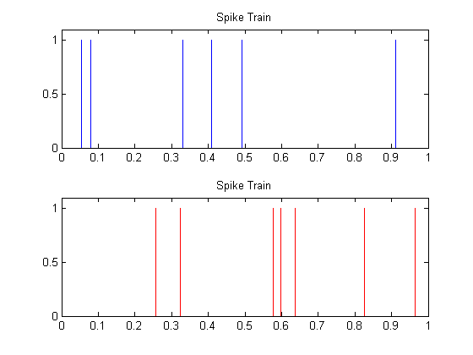
Spiking Neural Networks
Information is encoded in spike timing
Notes:
We talk about firing rates of neurons, measured over an interval
Do the individual spikes carry information
Looking for new classification methodologies that weren’t previously tried

Slide 11
Learning Rule
Remote Supervised Learning (ReSuMe)
Spike Time Dependent Plasticity (STDP) Hebbian learning rule

Slide 12
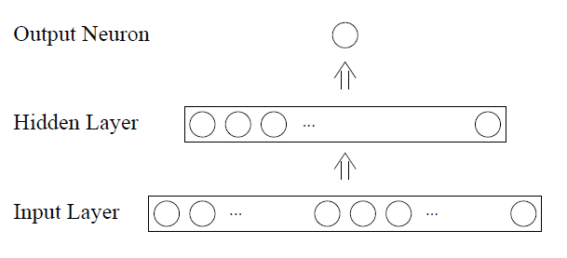
Neural Network Architecture
Time Encoding
1497 neurons
0 0.2 0.4 0.6 0.8 1 Voxel Data
50 us 70 us 90 us 110 us 130 us 150 us Time Value
Notes:
Input (1467), hidden, output(1)
Feed-forward connections
Tested on 2 layers since we have a linear problem
3 layers: ability to learn non-linearities
Normalize voxel data, round to nearest tenth

Slide 13
Reconstructions:
All decoders, V1,V2
Stimulus
1x1, V1
1x1, V1-LH
1x1, V1-RH

Slide 14
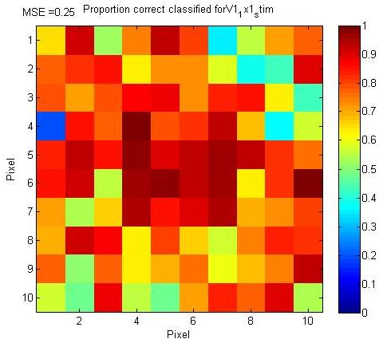
Accuracy of the 1x1 Decoder (V1)
% Correct Classified
V1 – 1x1 decoder
MSE = 0.25

Slide 15
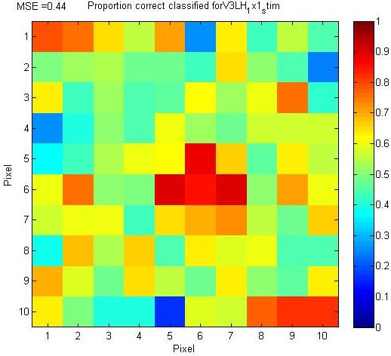
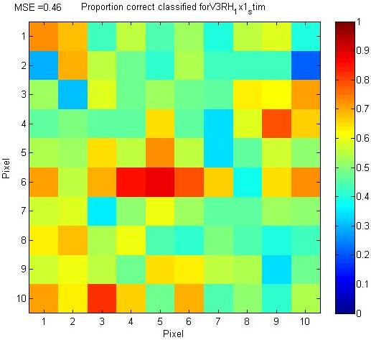
Left vs. Right Hemisphere – V3
V3 – Left HS
V3 – Right HS
MSE = 0.44
MSE = 0.46
Notes:
Compare Image Reconstructions after training the algorithm on one hemisphere only. Assumption: RH -> better reconstruction of left imagepart and vice versa. Better at the center (assumably fovea). No difference in left/right
Low accuracy expected, because neurons represent larger areas of the visual field.

Slide 16
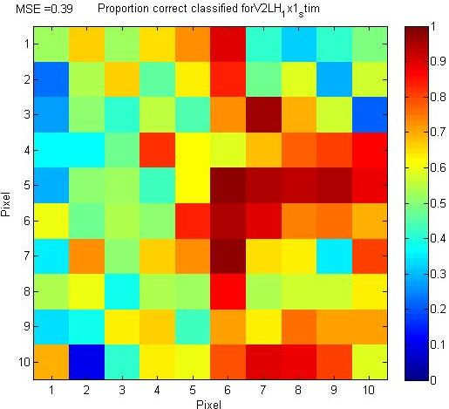
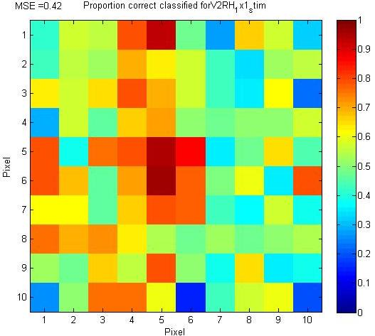
Left vs. Right Hemisphere – V2
V2 – Left HS
V2 – Right HS
MSE = 0.39
MSE = 0.42
Notes:
If we go down in the visual pathway

Slide 17
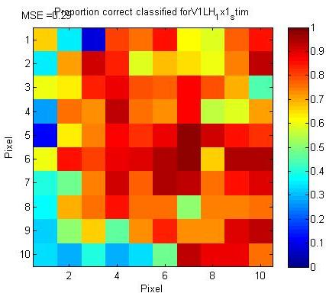
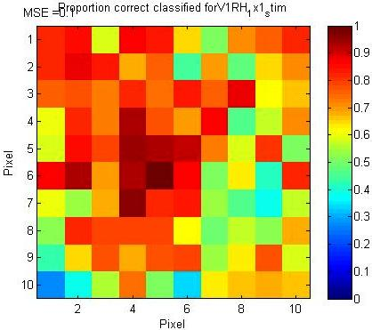
Left vs. Right Hemisphere – V1
V1 – Left HS
V1 – Right HS
MSE = 0.29
MSE = 0.22
Notes:
After training on the left hemisphere, the right image is as well better reconstructed and vice versa. But now we also find well reconstructed pixels from ipsilateral activity.
We discussed several possibilites why this might be the case:
Lack of control of visual gaze during the experiment
- Other low level features that are coded in V1 such as orientation
Voxel Correlations (MVPA)
… but we couldnt come up with a final explanation.
… and didnt have the time to come up with further analysis.

Slide 18
Future Directions
Using trained Weights of the right hemisphere on voxeldata of the left hemisphere
Different decoders
Horikawa et al. (2013): Neural decoding of visual imagery during sleep.
Notes:
If we had more time we would have liked to used the trained weights of one hemisphere on the voxeldata of the other hemisphere (The scientific question: how symmetric are retinotopic maps)

Slide 20
References
Miyawaki, Y., Uchida, H., Yamashita, O., Sato, M., Morito, Y., Tanabe, H. C., Sadato, N., Kamitani, Y. ``Visual image reconstruction from human brain activity using a combination of multi-scale local image decoders,'' Neuron, 60, 915-929 (2008). http://www.youtube.com/watch?v=daY7uO0eftA
Horikawa, T., Tamaki, M., Miyawaki, Y., Kamitani, Y. ``Neural decoding of visual imagery during sleep,'' Science, 340, pp.639 - 642 (2013).

