Slide 1
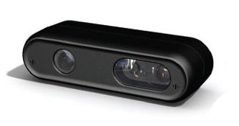
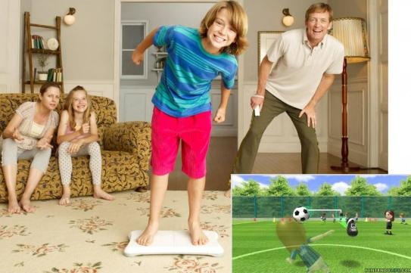
Kiwii Project
Kahori Kita
Yoshiyuki Sato
John Rocamora
Frank Schumann
Scott Yang

Slide 2
Motivation
Which joints are more important for balancing?
Is vision or proprioception more important for balancing?
Notes:
- Show the Wii / Kinect in Hardware(!)
Animation
-- Step on, -- Two Feet, -- One Foot, One Foot Eyes Closed , Back to Two Feet.
=> Center of Pressure jitters more with closed Eyes.

Slide 3
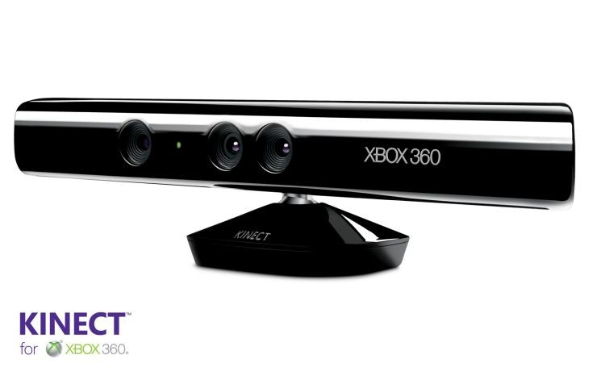
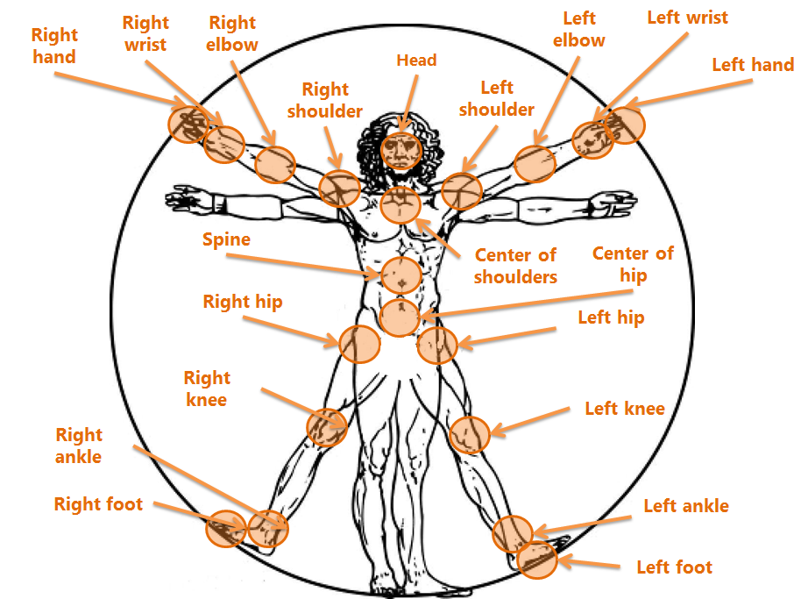
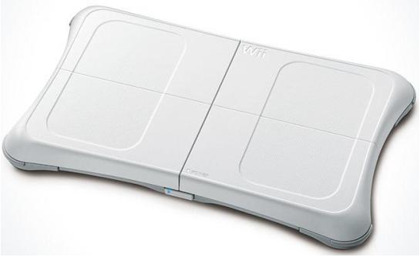
Setup
Center of Mass
Center of Pressure

Slide 4
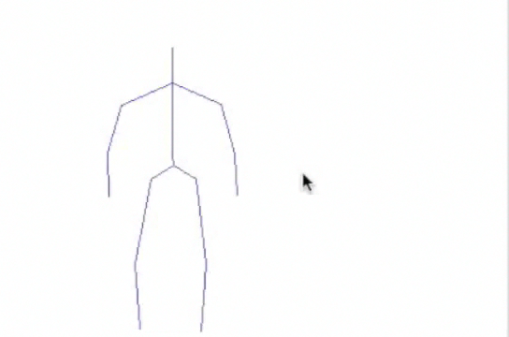
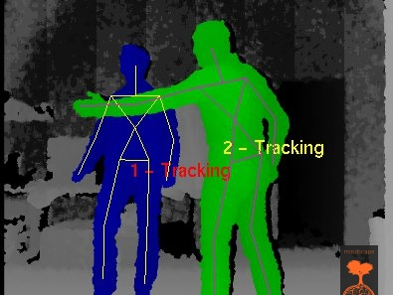
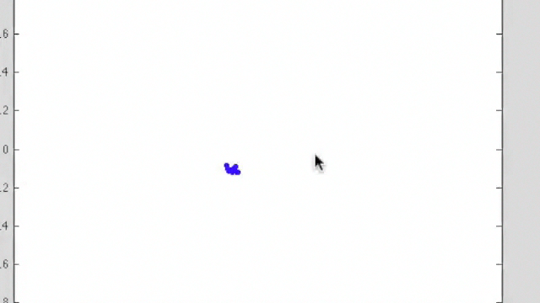
Raw KINECT data
Raw Wii data

Slide 5
Calibration
slope = 0.97
Position from WiiBoard
Position from KINECT

Slide 6
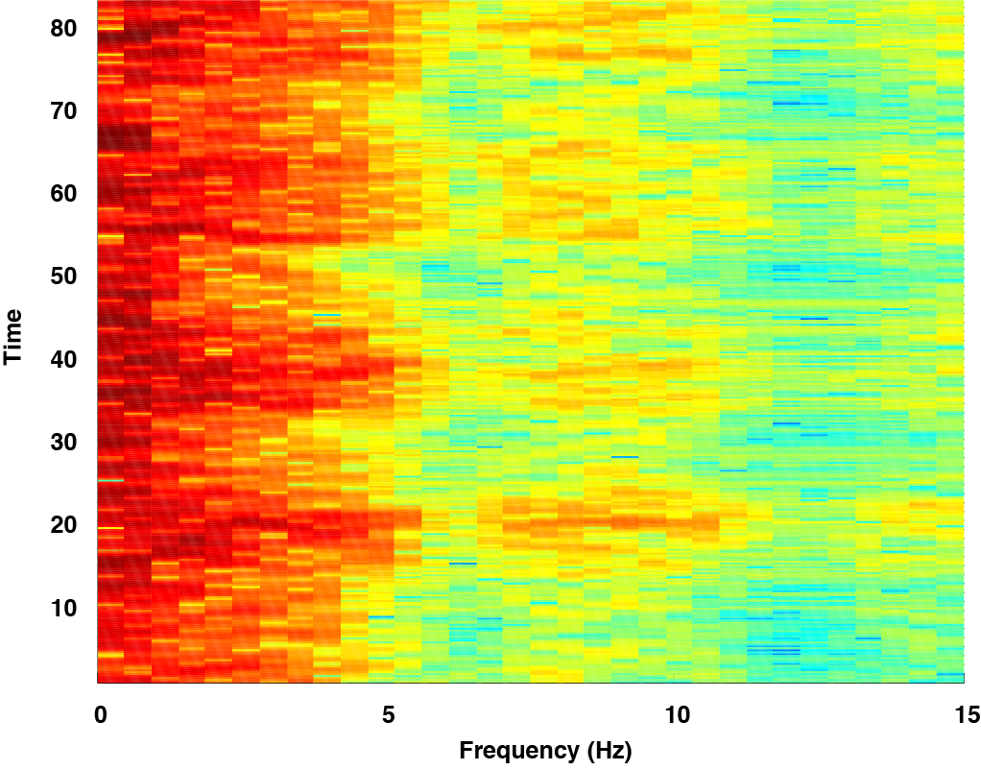
Spectrogram of Center of Pressure (Wii)
Eyes Closed
Eyes Open
Mean power frequency
Notes:
Time Frequency Plot:
With closed eyes, the COP jiggles more. Mean Power Frequency picks that

Slide 7
MPF of CoM(Wii) - eyes open/eyes closed
: Condition(posture)
Eyes closed
x
Eyes open
Mean power frequency [Hz]
But the classification across postures is not trivial.

Slide 8
Classify Eye‘s Open / Closed
0
1
1
0
0
0
1
0
X1 | X2 |  |  |  |  |  |  | Xm | Trial1
 |  |  |  |  |  |  |  |  | Trial2
 |  |  |  |  |  |  |  |  | trialN
Corr(head, right knee)
Liner SVM:76%

Slide 9




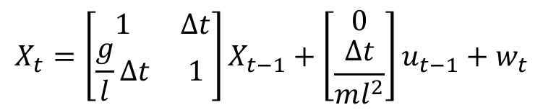




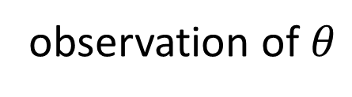

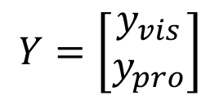

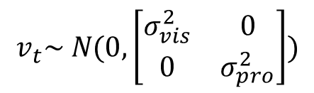


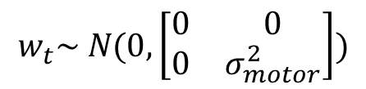

Kalman filter & LQR
m
$$X=\left[\begin{matrix}θ \\ \dot{θ}\end{matrix}\right]$$
state
$$θ$$
$$Y=\left[\begin{matrix}y_{vis} \\ y_{pro}\end{matrix}\right]$$
mg
observation of $θ$
l
$$u_{t−1}$$
$$u_{t}$$
$$u_{t+1}$$
u
u
u
u
$X_{t−1}$
$X_{t}$
$X_{t+1}$
$$ml^{2}\ddot{θ}≃mgl θ+u$$
$Y_{t−1}$
$Y_{t}$
$Y_{t+1}$
$$X_{t}=\left[\begin{matrix}1 & Δt \\ \frac{g}{l}Δt & 1\end{matrix}\right]X_{t−1}+\left[\begin{matrix}0 \\ \frac{Δt}{ml^{2}}\end{matrix}\right]u_{t−1}+w_{t}$$
$$w_{t}\sim N(0,\left[\begin{matrix}0 & 0 \\ 0 & σ_{motor}^{2}\end{matrix}\right])$$
$$v_{t}\sim N(0,\left[\begin{matrix}σ_{vis}^{2} & 0 \\ 0 & σ_{pro}^{2}\end{matrix}\right])$$
$$Y_{t}=\left[\begin{matrix}1 & 0 \\ 1 & 0\end{matrix}\right]X_{t}+v_{t}$$

Slide 10
Center of mass
Auto-correlation
0.04
1
0.8
0.6
eyes
closed
0.02
0.4
0.2
0
-0.2
0
-0.4
-0.6
-0.8
-0.02
0
400
800
1200
1600
-1
0
400
800
1200
1600
0.03
1
0.8
0.02
0.6
eyes
open
0.4
0.01
0.2
0
-0.2
0
-0.4
-0.6
-0.01
-0.8
0
400
Time
800
1200
-1
0
400
800
1200
Delay

Slide 11
Conclusion
Which joints are more important for balancing?
Is vision or proprioception more important for balancing?
Notes:
- Show the Wii / Kinect in Hardware(!)
Animation
-- Step on, -- Two Feet, -- One Foot, One Foot Eyes Closed , Back to Two Feet.
=> Center of Pressure jitters more with closed Eyes.

Slide 12
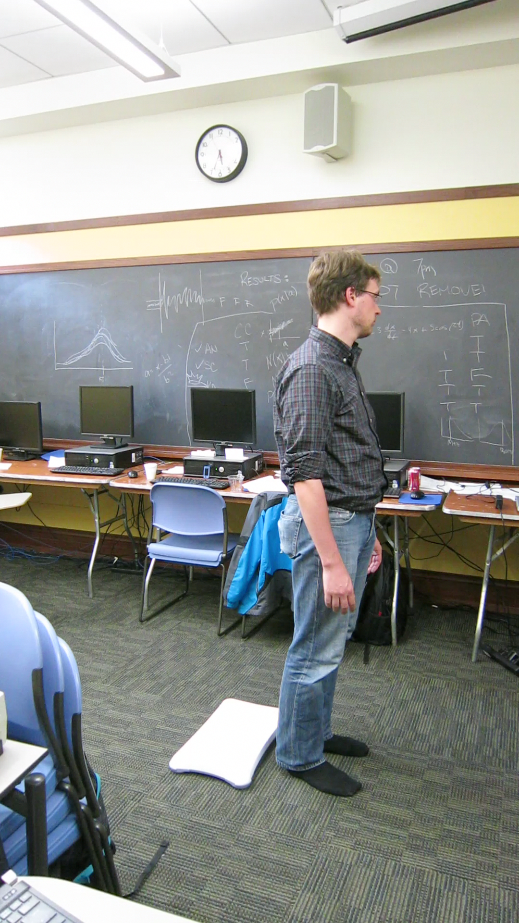
Thank
You!

