Slide 1
Advice for young scientists
Luis A. Nunes Amaral
Howard Hughes Medical Institute
Dept. of Chemical and Biological Engineering
Dept. of Medicine
Northwestern Institute on Complex Systems

Slide 2
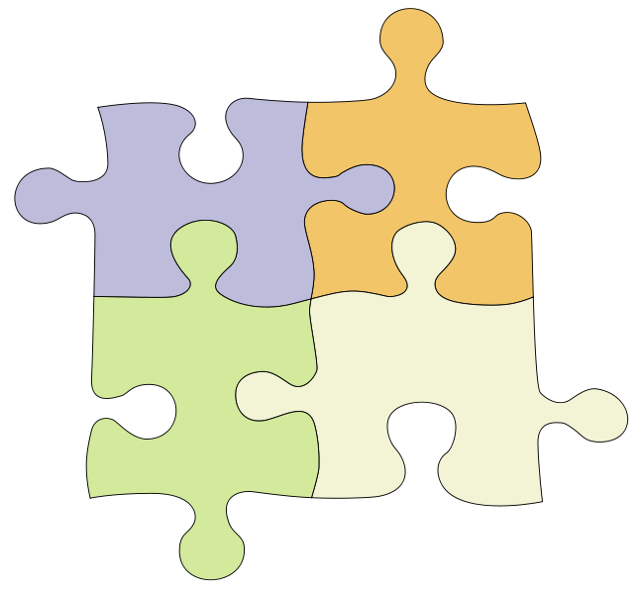
Challenges
Comunicating
Getting
Funded
&
Well
Often
Becoming
Doing Great
Research
Known
Puzzle borrowed from http://masenomathscamp.net

Slide 3
Apprenticeship

Slide 4
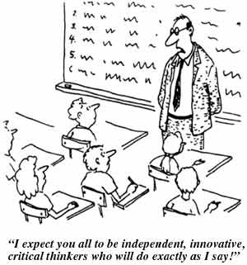
If it was only that simple…

Slide 5
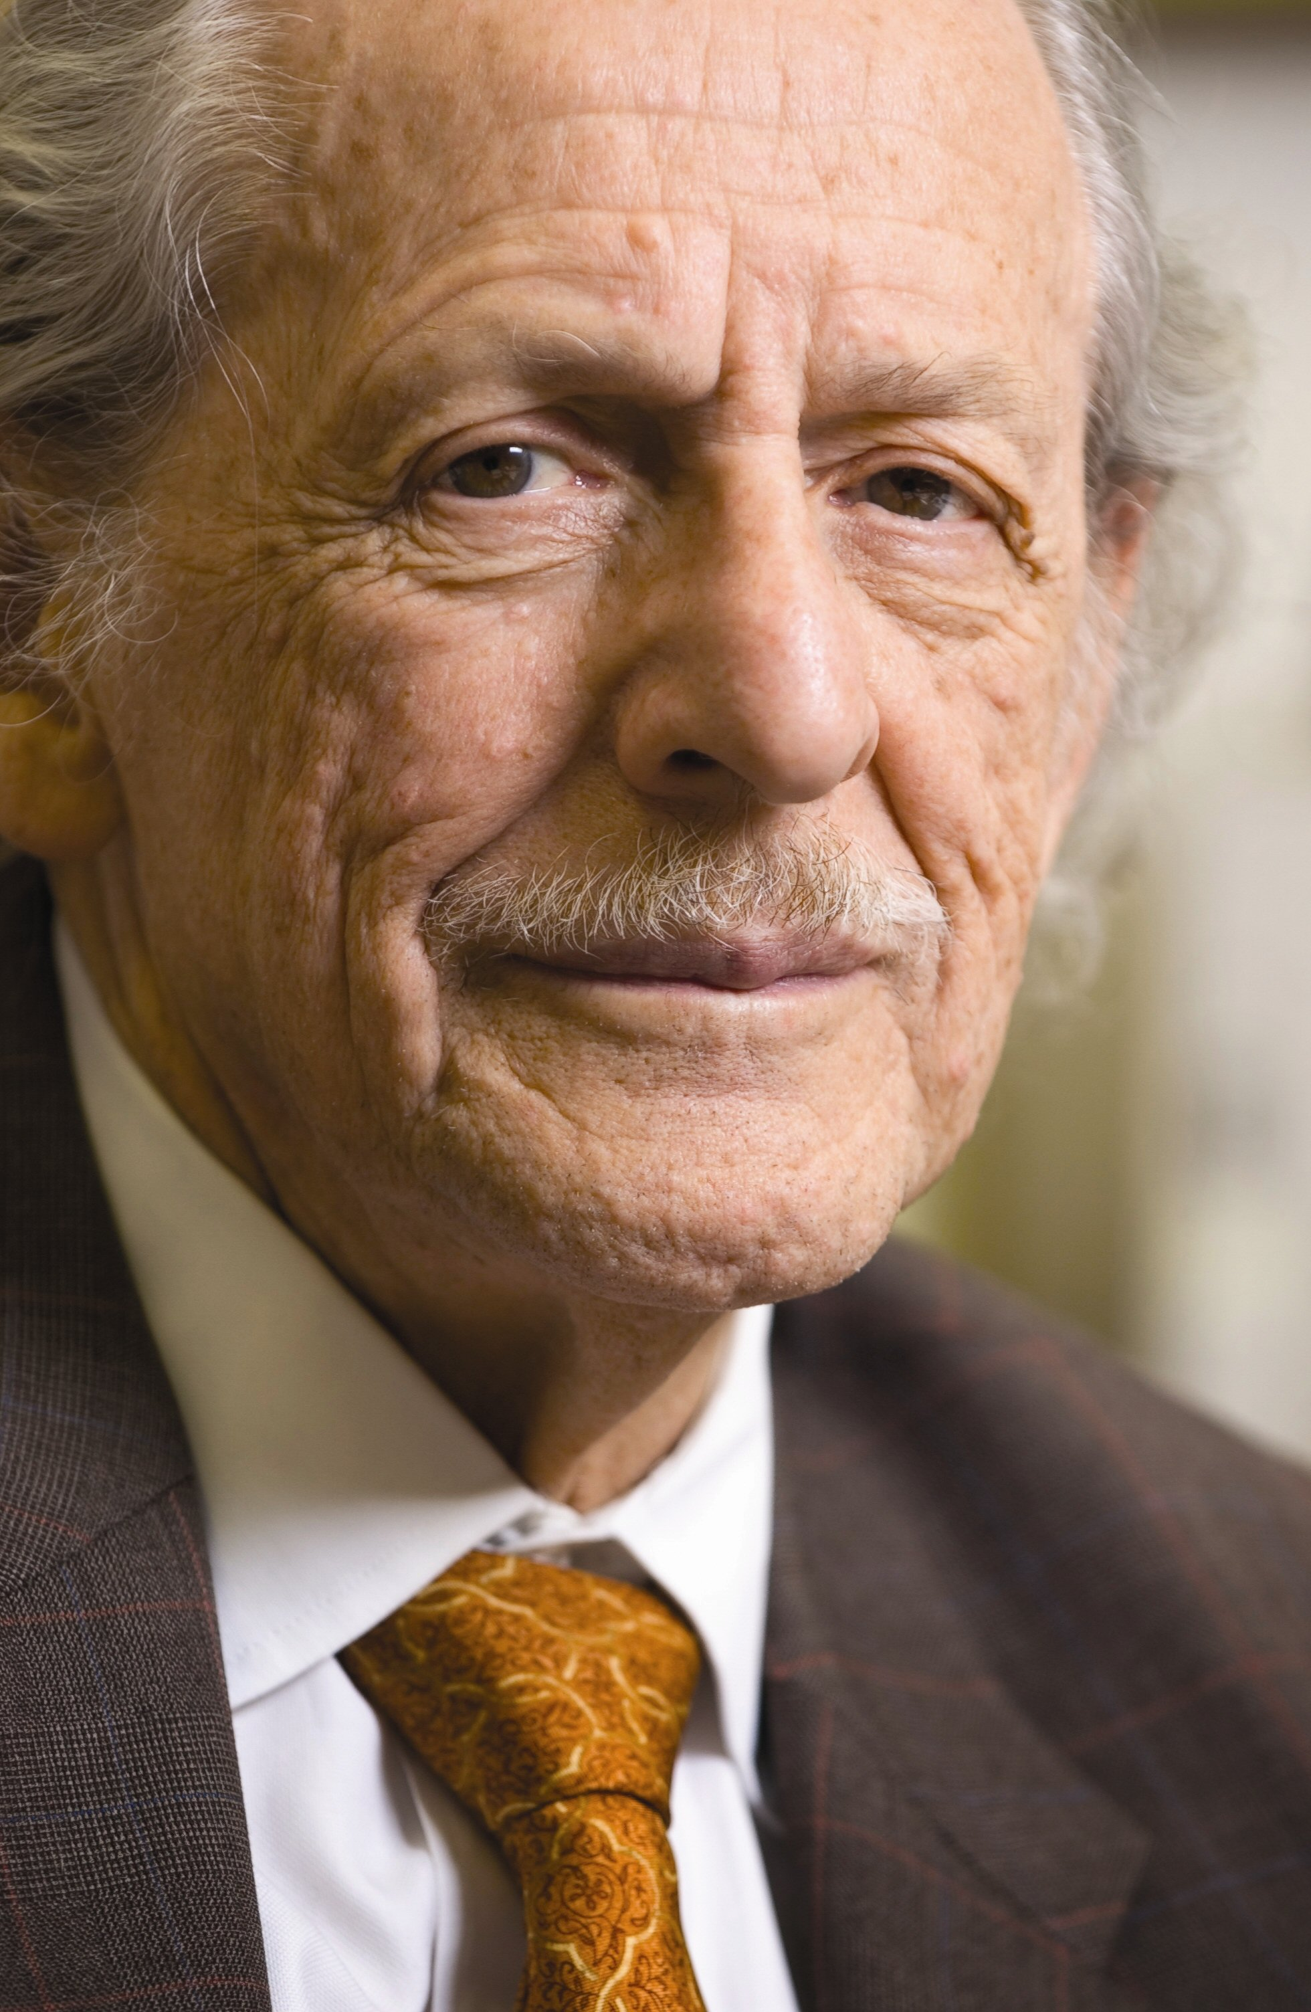
Detecting great research
Citations are the currency of
science
Eugene Garfield (ISI)

Slide 6
Total citations are a result of…
q = Scientific field +
Authors’ reputation +
Authors’ prior work in field +
Timeliness/Relevance to peers +
Originality of problem +
Originality of approach +
Unexpectedness of results +
Significance of results +
Strength of evidence +
Quality of exposition +
Quality of figures + …
Stringer, Sales-Pardo & Amaral, PLoS One 3, e1683 (2008)

Slide 7
Suggesting that:
Number of citations to papers published by a researcher or in a journal may be normally (or, perhaps, log-normally) distributed.
Papers by a given researcher may receive a typical number of citations.
Papers published in a given journals may also receive a typical number of citations.
Stringer, Sales-Pardo & Amaral, PLoS One 3, e1683 (2008)

Slide 8
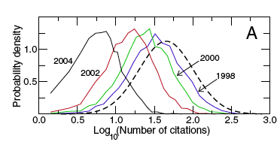
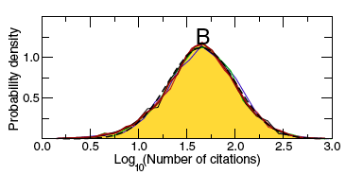
Journal citation distribution
Journal of Biological Chemistry
Stringer, Sales-Pardo & Amaral, PLoS One 3, e1683 (2008)

Slide 9
What can one do to succeed?
Comunicating
Getting
Funded
&
Well
Often
Becoming
Doing Great
Research
Known
Puzzle borrowed from http://masenomathscamp.net

Slide 10
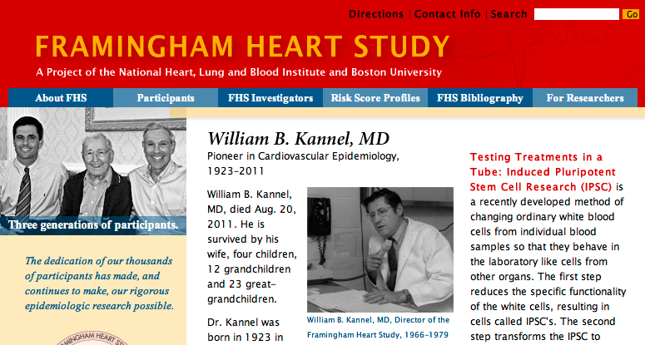
Data-driven approach

Slide 11
Framingham Heart Study
5,209 men and women between the ages of 30 and 62
Extensive physical examinations and lifestyle interviews repeated every two years
Research Milestones
1960 Cigarette smoking found to increase the risk of heart disease
1961 Cholesterol level, blood pressure, and electrocardiogram abnormalities found to increase the risk of heart disease
1967 Physical activity found to reduce the risk of heart disease and obesity to increase the risk of heart disease
1970 High blood pressure found to increase the risk of stroke
1976 Menopause found to increase the risk of heart disease
1978 Psychosocial factors found to affect heart disease
1988 High levels of HDL cholesterol found to reduce risk of death

Slide 12
What can one do to succeed?
Comunicating
Getting
Funded
&
Well
Often
Becoming
Doing Great
Research
Known
Puzzle borrowed from http://masenomathscamp.net

Slide 13
Doing great research
When does discovery/innovation occur?
What can one do to foster discovery?

Slide 14
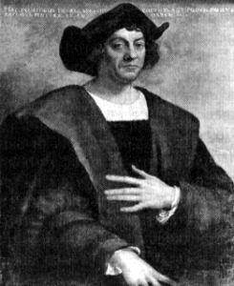
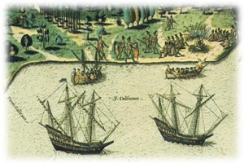
Right place, right time
Christopher Columbus never abandoned the belief that he had reached Asia.

Slide 15
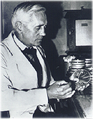
Right place, right time
Upon returning from his August vacation, Alexander Fleming discovered that a fungus of the Penicillium genus had, by chance, contaminated a bacterial culture, killing the closest colonies.

Slide 16
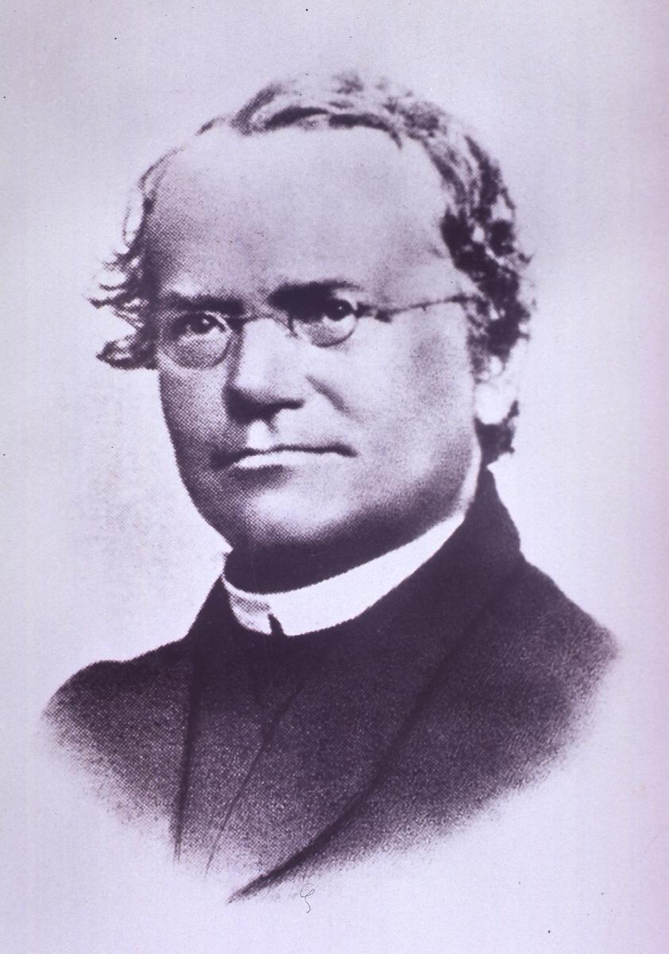
Knowledge transfer
Gregor Mendel had been trained in mathematics and learned how to design experiments and analyze data.
Botanists of Mendel's time were not accustomed to statistics and so couldn't recognize the importance of Mendel's discovery.

Slide 17
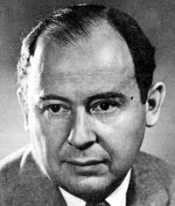
Knowledge transfer
John von Neumann made important contributions in quantum physics, computer science, economics and many mathematical fields.
Von Neumann developed the mathematical basis of game theory, but “…had von Neumann and Morgenstern never met, it seems unlikely that game theory would have been developed."

Slide 18
Doing great research
When does discovery/innovation occur?
What can one do to foster discovery?

Slide 19
What can one do?
Leave my comfort zone
Team work
Mentor and be mentored
Does mentor fecundity correlate with other measures of academic productivity and recognition?
Does mentor fecundity impact fecundity of protégés?

Slide 20
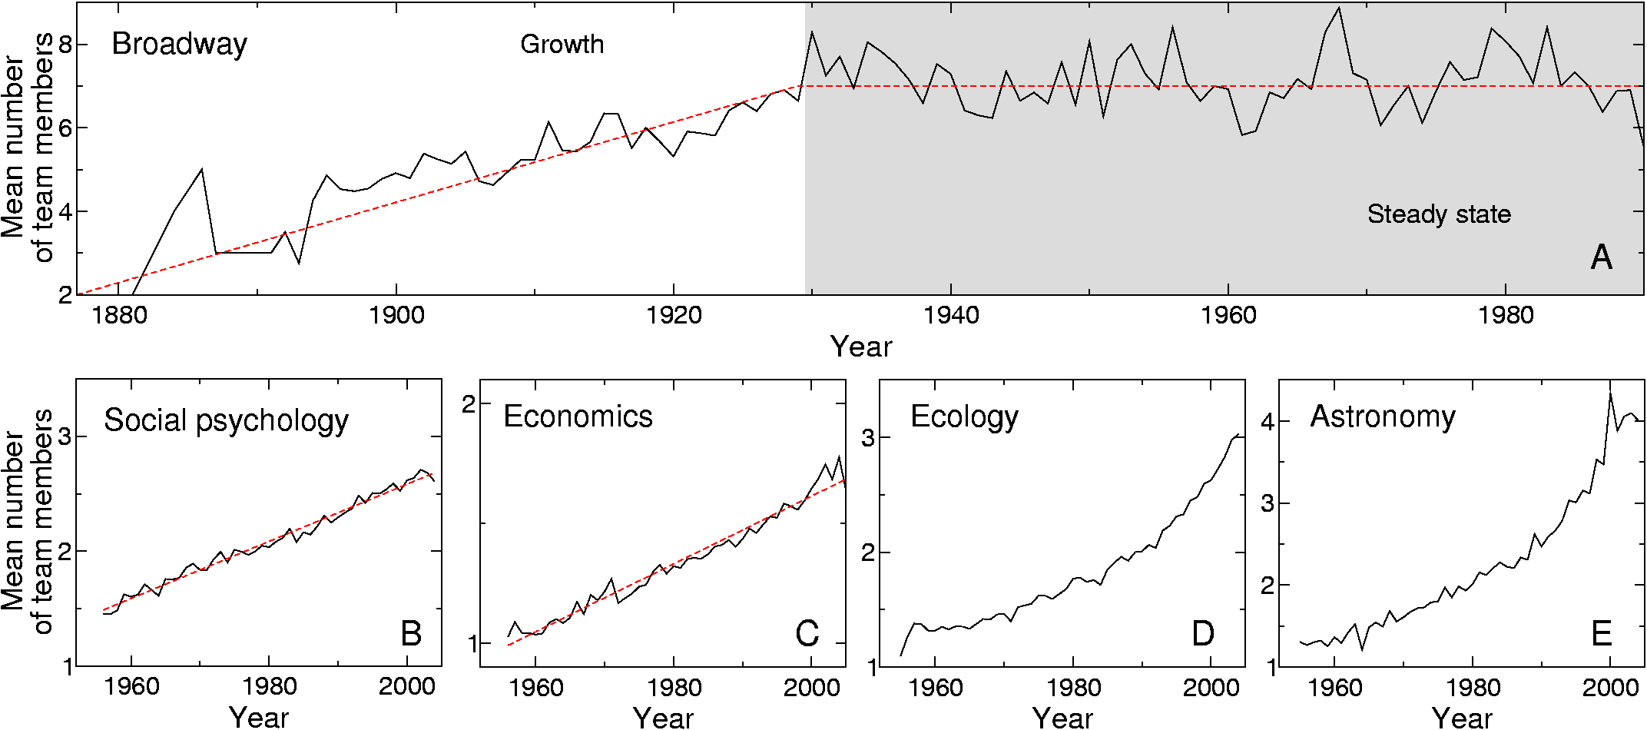
Teams
Guimera, Uzzi, Spiro & Amaral, Science 308, 697 (2005)

Slide 21
Team characteristics

Slide 22
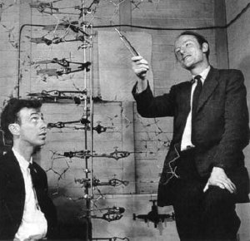
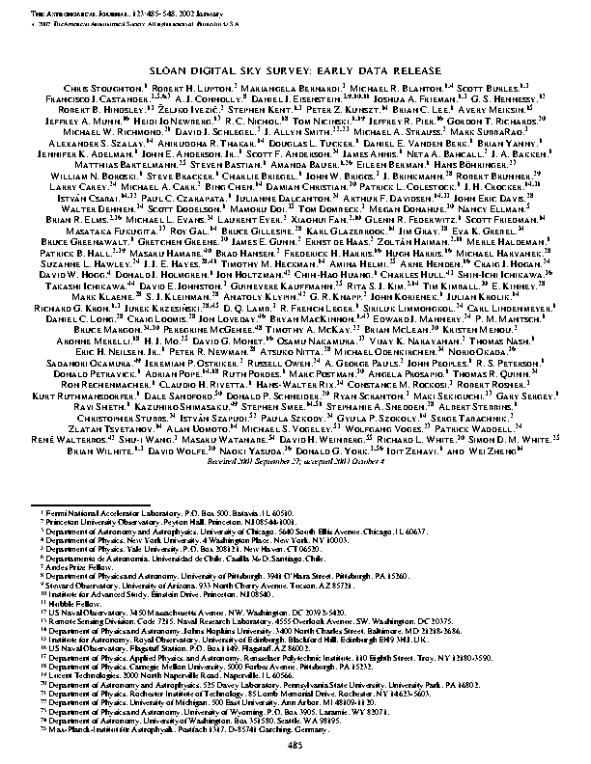
Measuring team size
Team size is 2 (actually 4)
Team size is 192

Slide 23
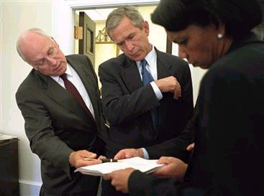
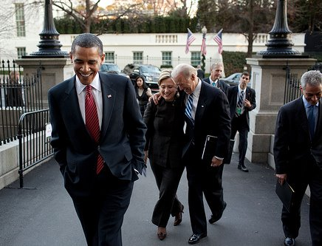
Measuring diversity

Slide 24
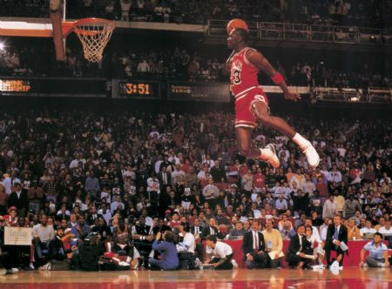
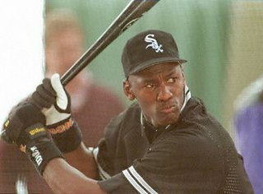
Measuring expertise

Slide 25
Data
Field | Period | Teams | Agents | Journals
Broadway | 1877-1990 | 2,258 | 4,113 | ----
Social psychology | 1955-2004 | 16,526 | 23,029 | 7
Economics | 1955-2004 | 14,870 | 23,236 | 9
Ecology | 1955-2004 | 26,888 | 38,609 | 10
Astronomy | 1955-2004 | 30,552 | 30,192 | 6
Guimera, Uzzi, Spiro & Amaral, Science 308, 697 (2005)

Slide 26
Team size
Guimera, Uzzi, Spiro & Amaral, Science 308, 697 (2005)

Slide 27
Team characteristics
p probability of a team member being an incumbent
q tendency to repeat past collaborations rather than initiate new ones

Slide 28
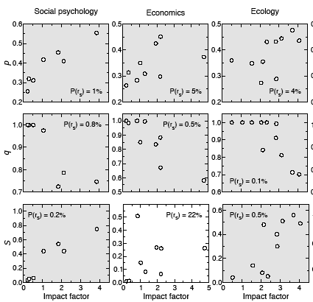
Impact increases with
Increasing experience of team members
Decreasing probability of repeating collaborations
Increasing size of community
Guimera, Uzzi, Spiro & Amaral, Science 308, 697 (2005)

Slide 29
What can one do?
Leave my comfort zone
Team work
Mentor and be mentored
Does mentor fecundity correlate with other measures of academic productivity and recognition?
Does mentor fecundity impact fecundity of protégés?

Slide 30
Large longitudinal database
Studied career of 7,259 mathematicians who obtained their Ph.D. between 1900 and 1960
Malmgren, Ottino, Amaral, Nature (2010)

Slide 31
Proxies of academic success
469 members of NAS
4,447 mathematicians with publication counts
7,259 mathematicians with fecundity counts
Malmgren, Ottino, Amaral, Nature (2010)

Slide 32
What can one do?
Leave my comfort zone
Team work
Mentor and be mentored
Does mentor fecundity correlate with other measures of academic productivity and recognition?
Does mentor fecundity impact fecundity of protégés?

Slide 33
Fecundity of protégés
 | k<3 | 3≤k < 10 | K ≥10
1st third of career | 37% larger | --- | 29% larger
2nd third of career | 37% larger | --- | ---
3rd third of career | 37% larger | --- | 31% smaller
Malmgren, Ottino, Amaral, Nature (in press)

Slide 34
Take home messages
Eat your vegetables
Avoid saturated fat
Exercise
Collaborate broadly and often
Choose mentors broadly and wisely

